Slide 1



PRESENTATION BY VPR MINING EMPLOYEES – JAYANTH PROJECT – NORTHERN COAL FIELDS – INDIA.
SAFE MINING – A PRESPECTIVE

Slide 2


EMPLOYEE WELFARE
“Leadership is not a position. It consists of action with transparency and to set high example of integrity, honesty and to strive for welfare of all.”

Slide 3
EMPLOYEE STRENGTH AT VPR MINING,NCL JAYNT
TOTAL STRENGTH - 829 Members
VTC COMPLETED FOR - 829 Members
IME COMPLETED FOR - 829 Members
PERSONAL PROTECTIVE EQUIPMENTS ISSUED FOR- 829 Members

Slide 4
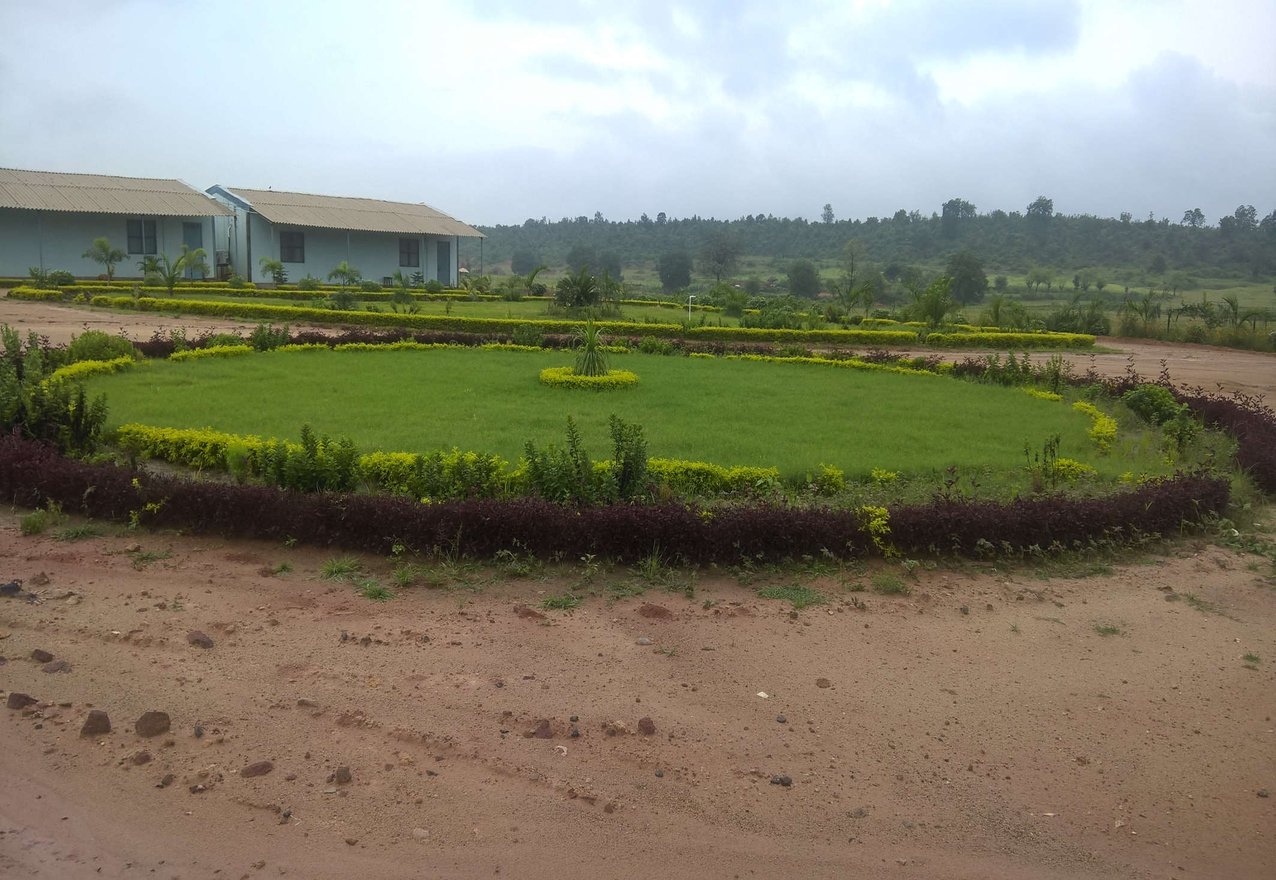
VPR CAMP GARDEN – Developed by Employees
“Show me your garden and I shall tell you what you are.”
-Alfred Austin

Slide 5
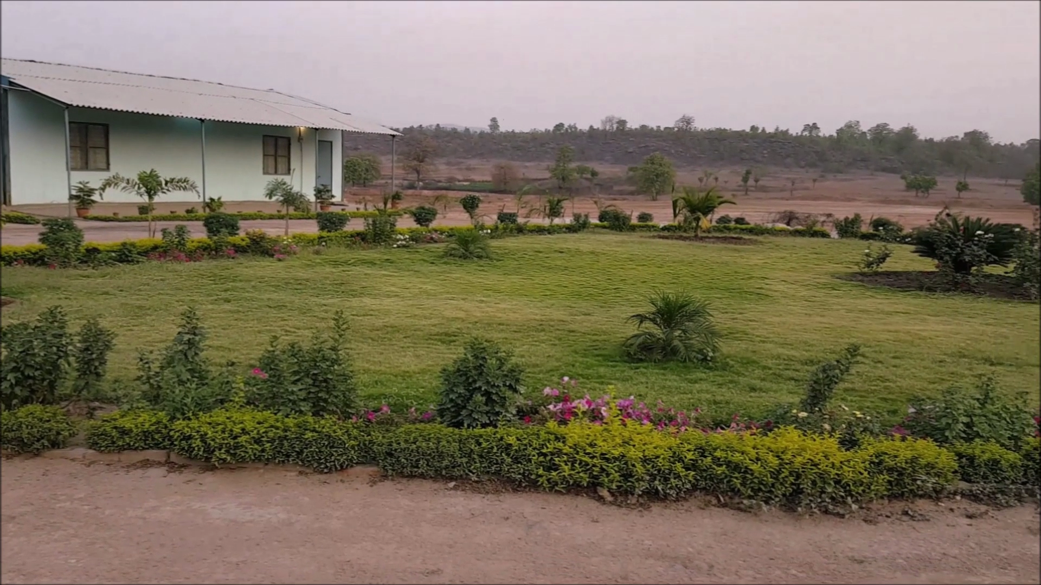
VPR CAMP GARDEN – Always Green

Slide 6
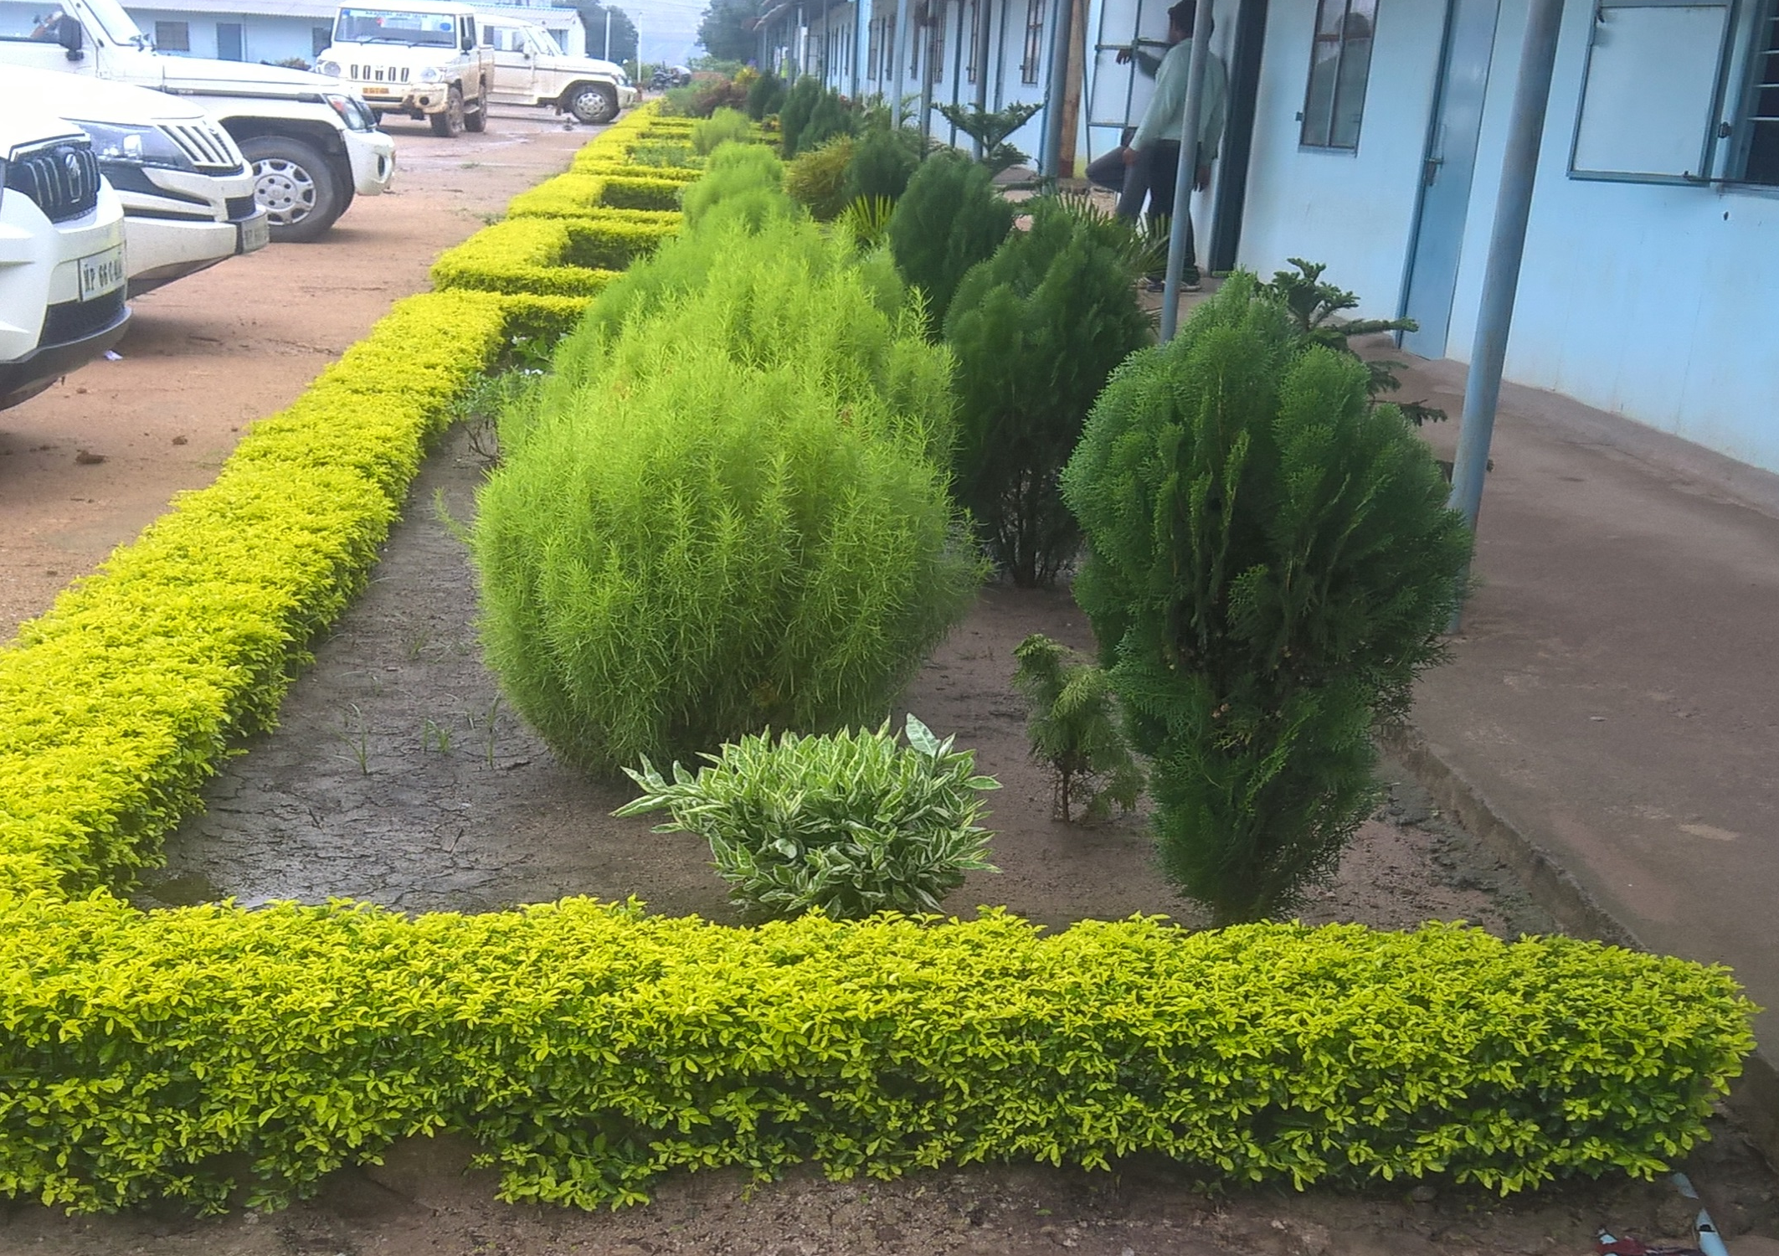
VPR CAMP GARDEN – Green initiative of all at VPR

Slide 7
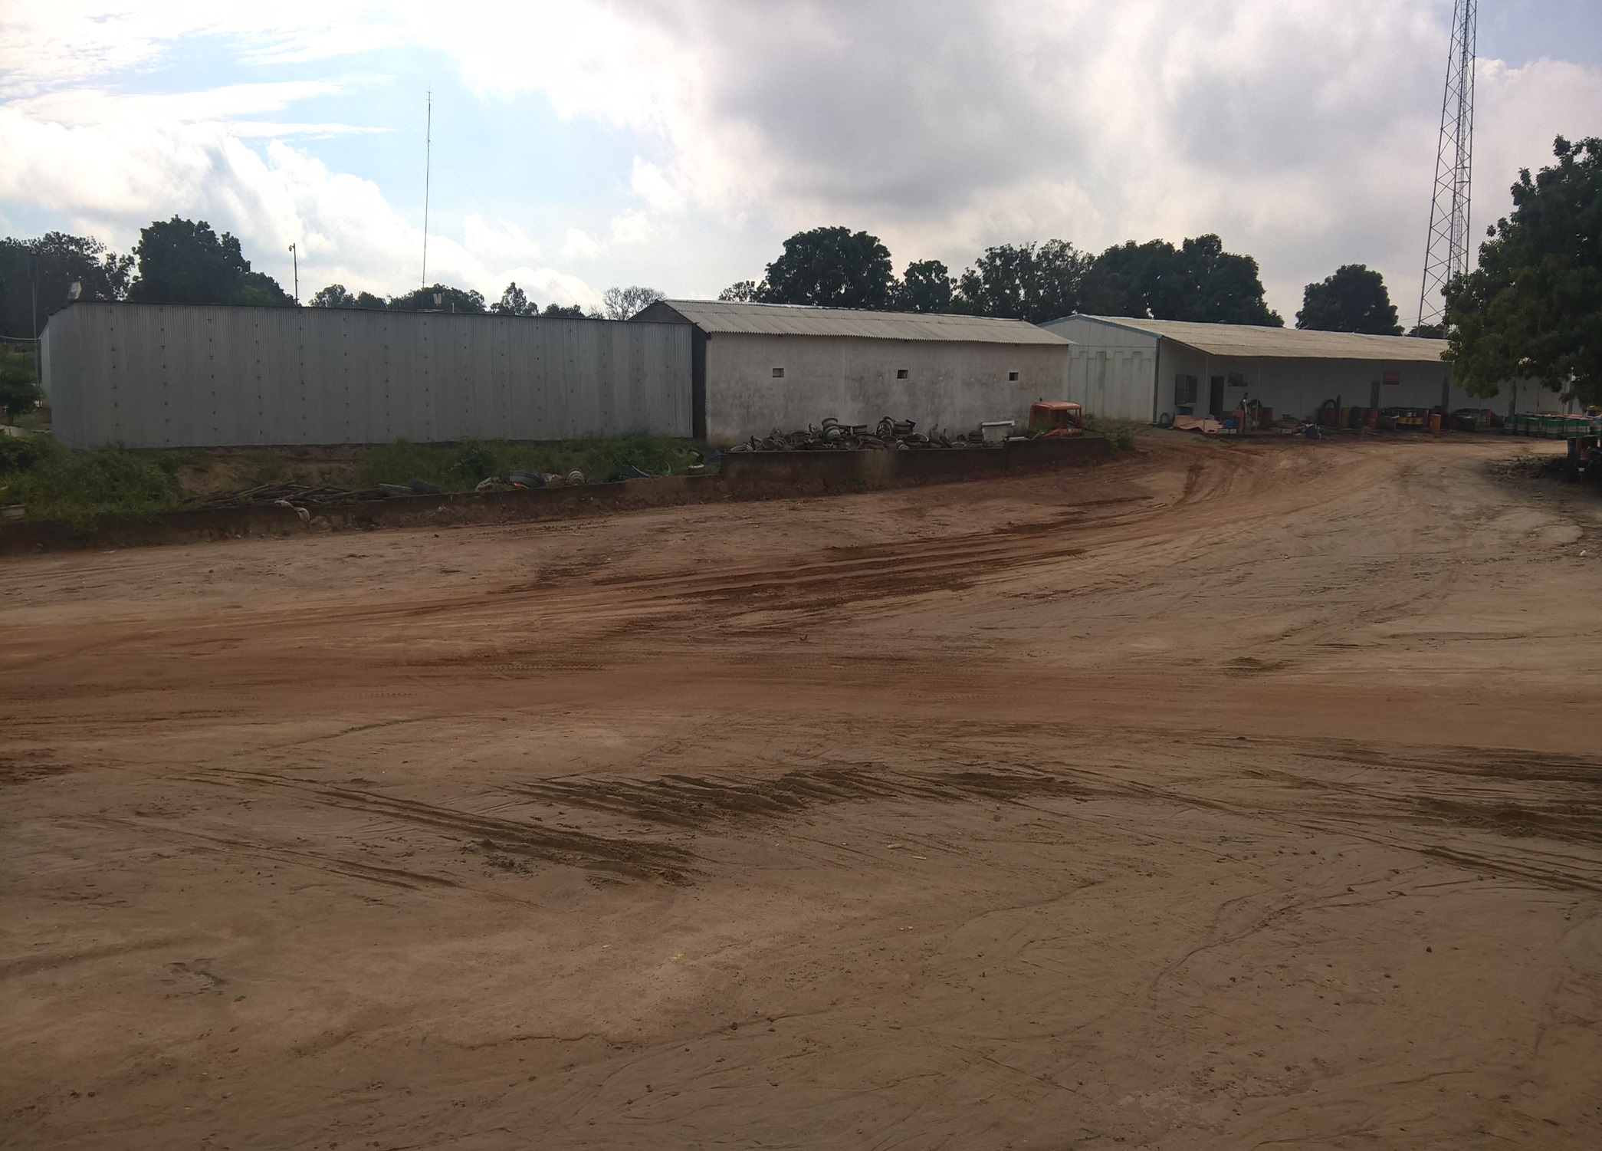
VPR CAMP VIEW – From outside of Entry Gate .

Slide 8
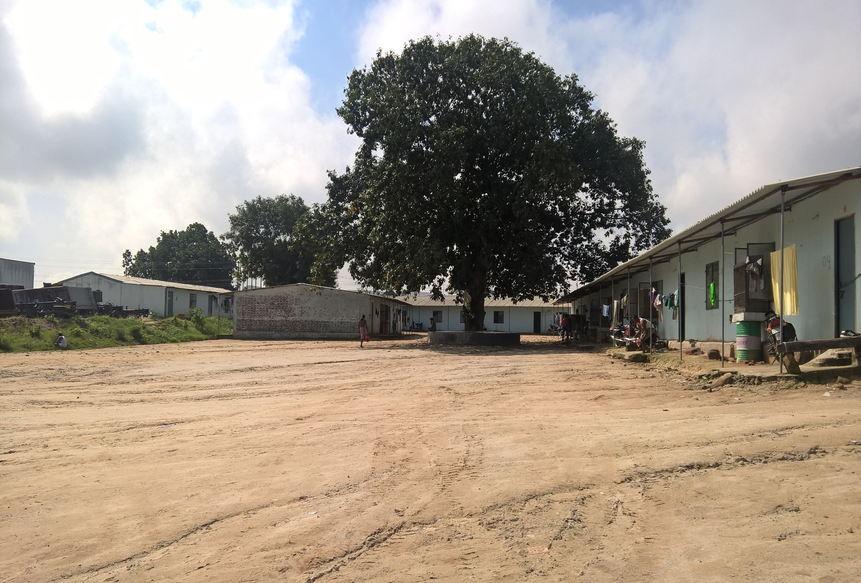
VPR CAMP VIEW – Long Shot

Slide 9
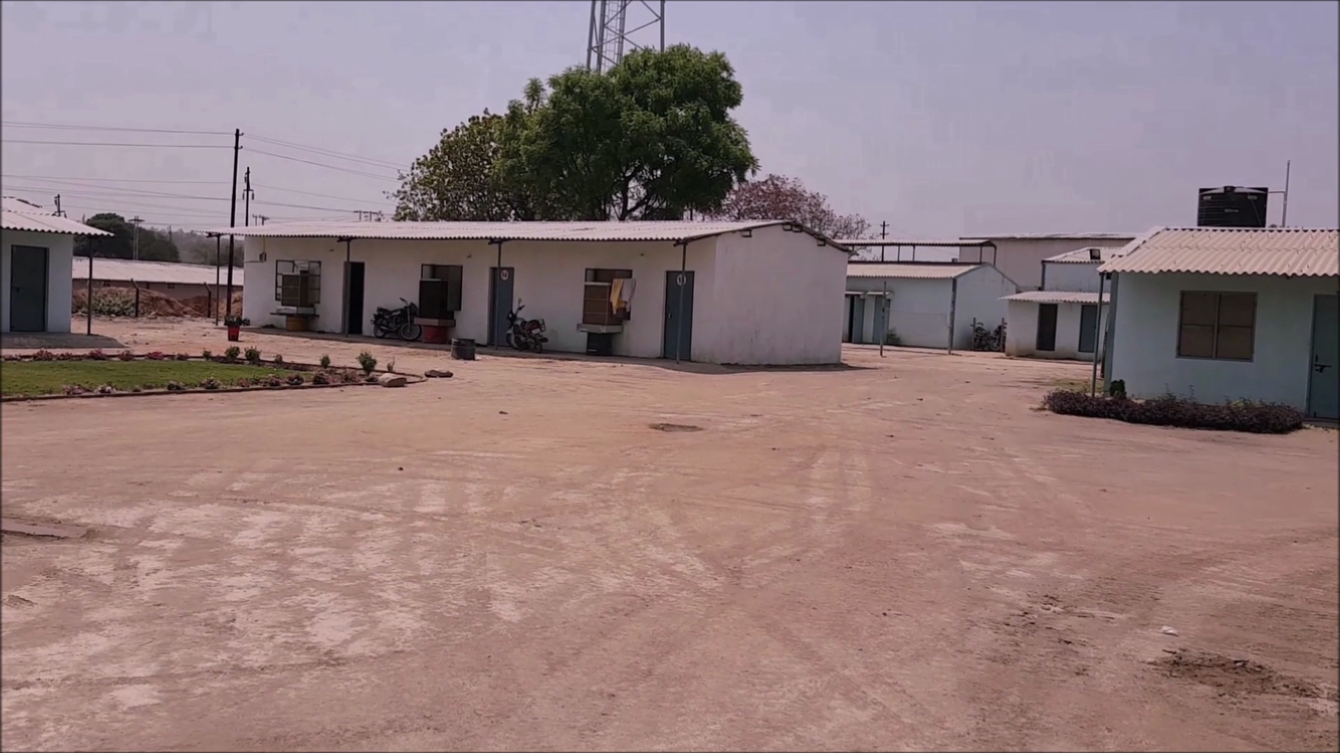
CAMP- EMPLOYEE QUARTERS – A view from outside.

Slide 10
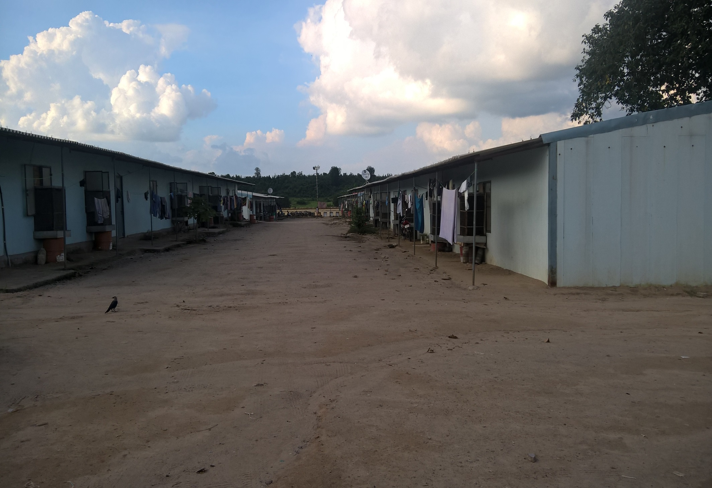
CAMP - EMPLOYEE QUARTERS – Planned Construction

Slide 11
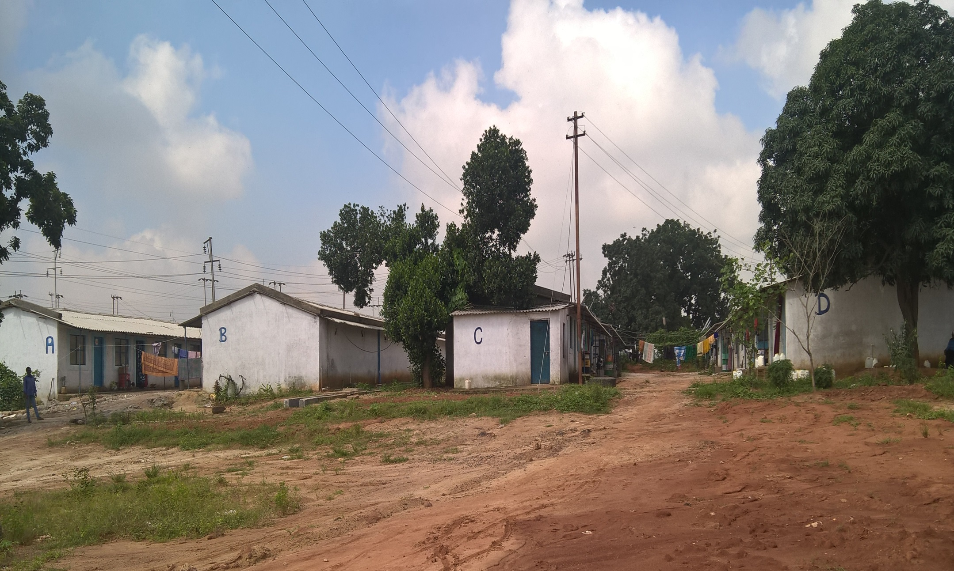
CAMP- EMPLOYEE FAMILY QUARTERS – Family First.

Slide 12
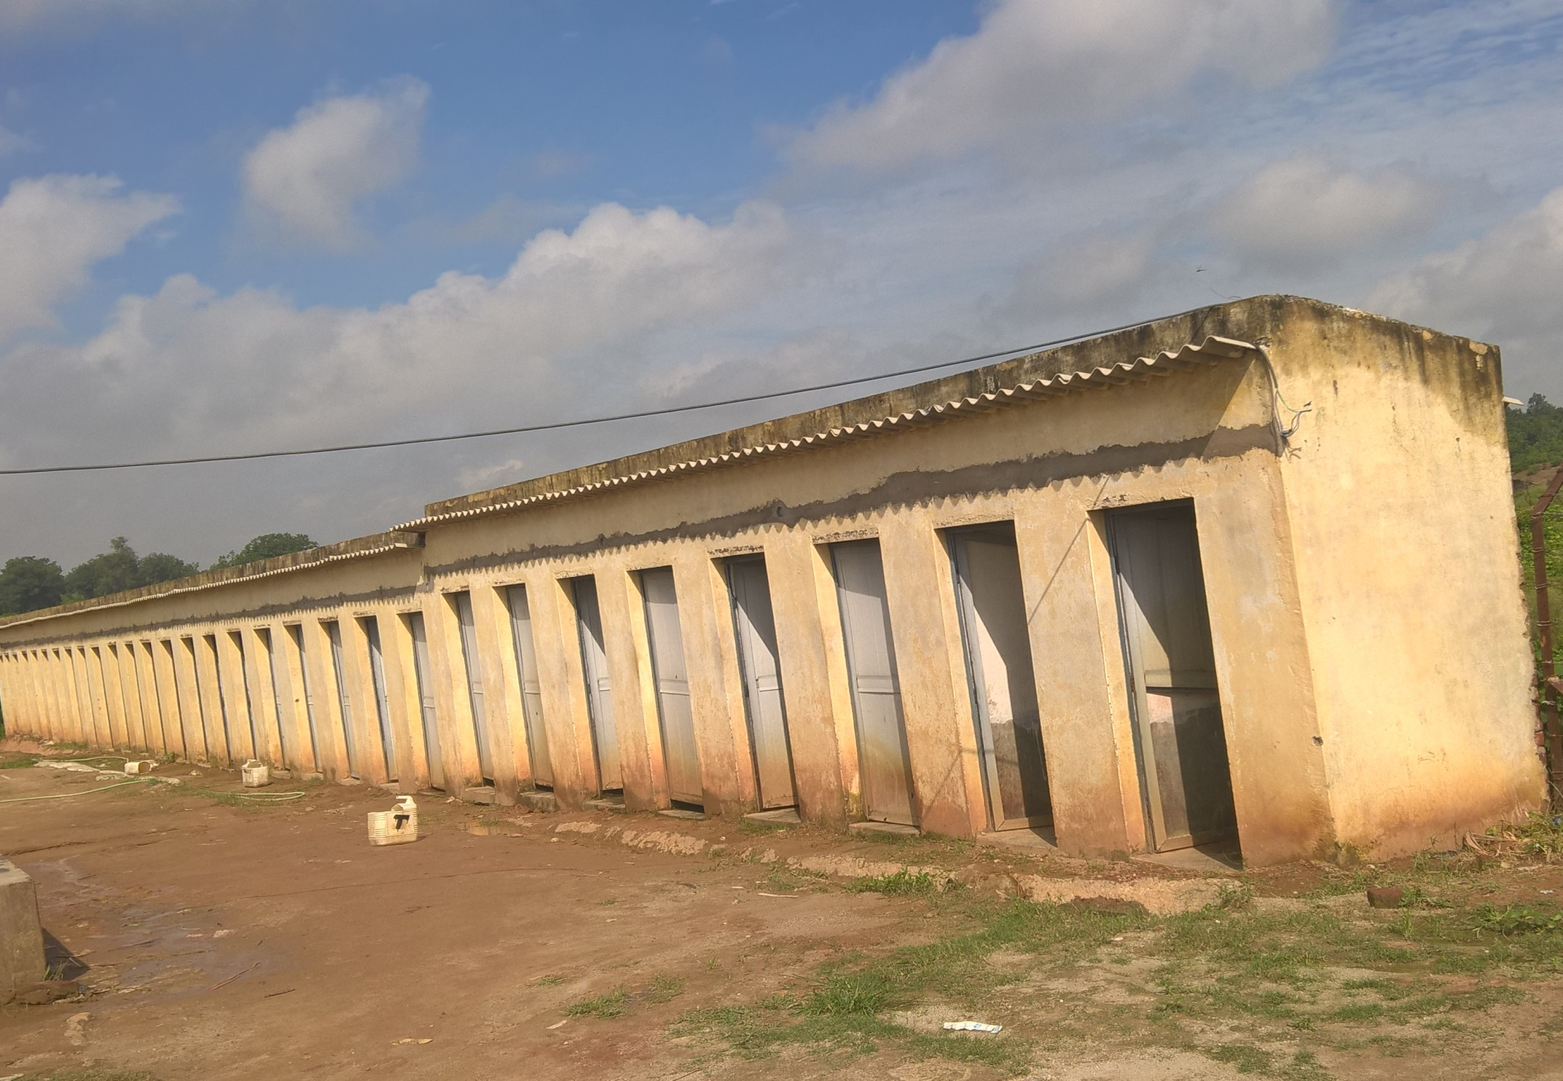
CAMP-EMPLOYEE LAVATORY – Clean & Hygienic .

Slide 13
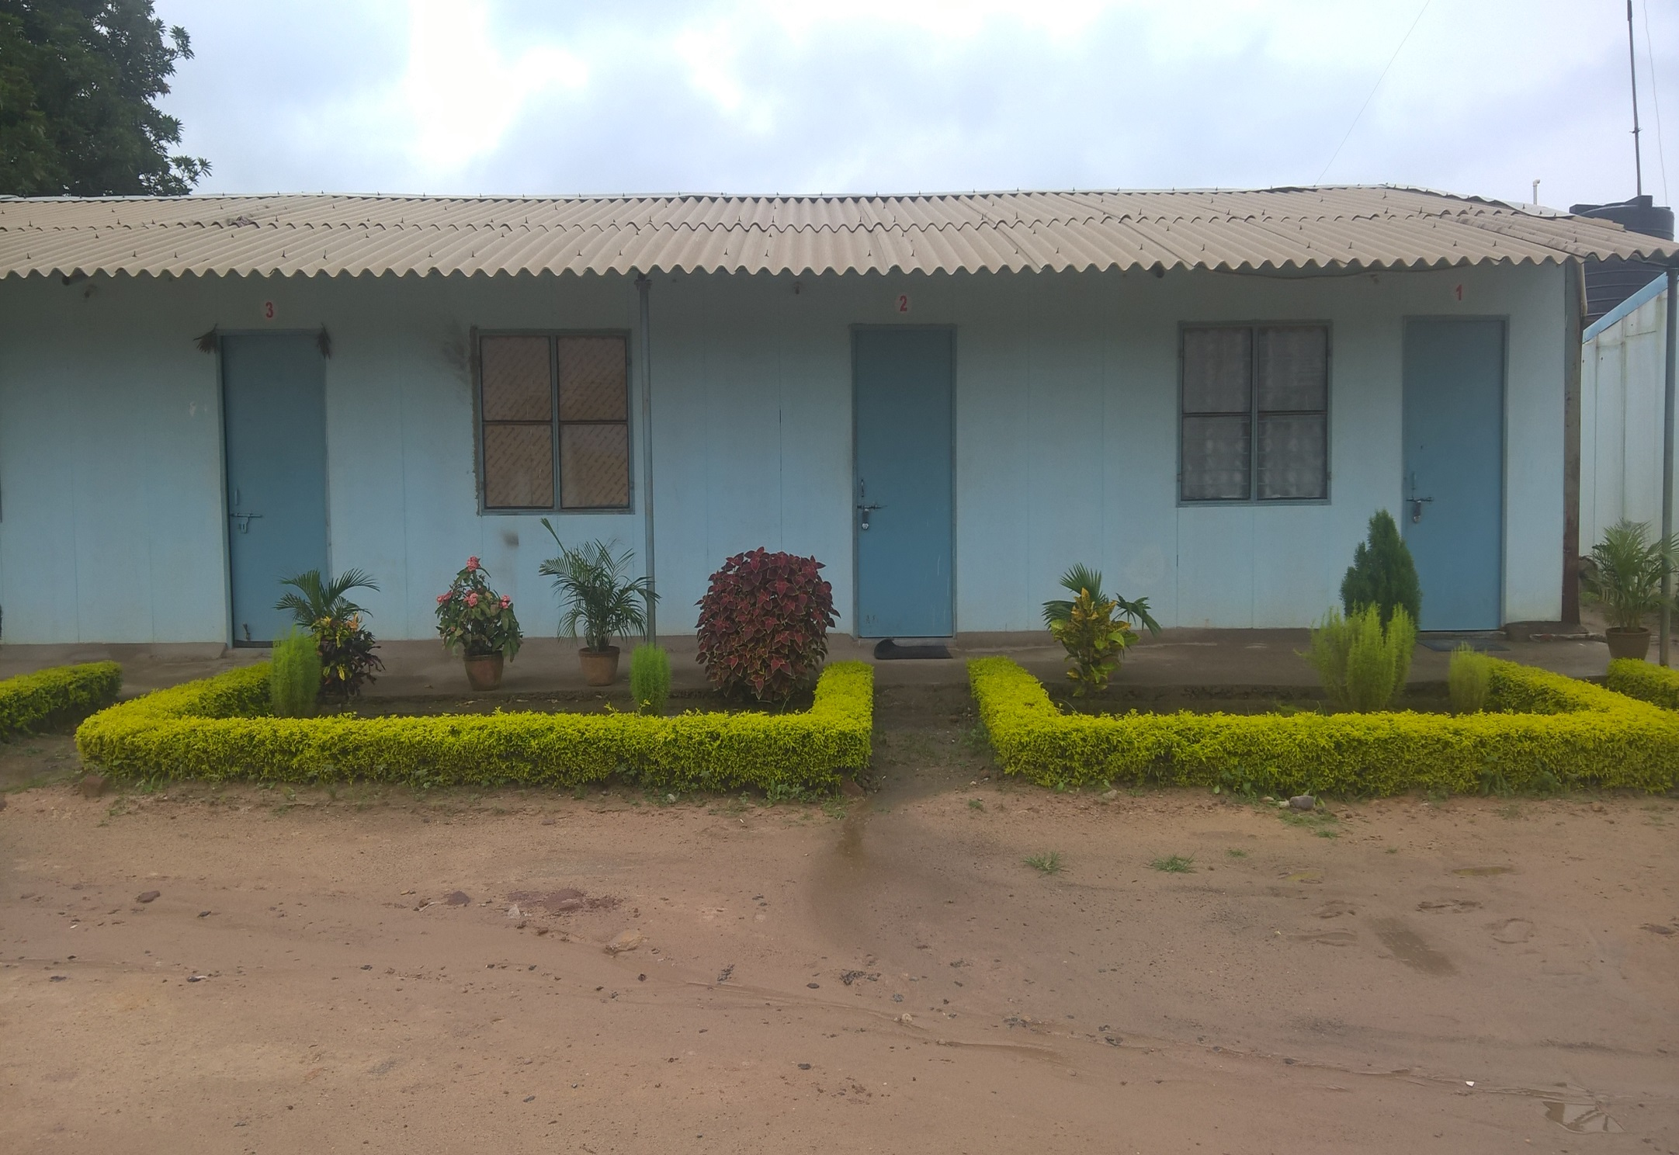
CAMP-EMPLOYEE WORKING ROOMS – Serene View.

Slide 14
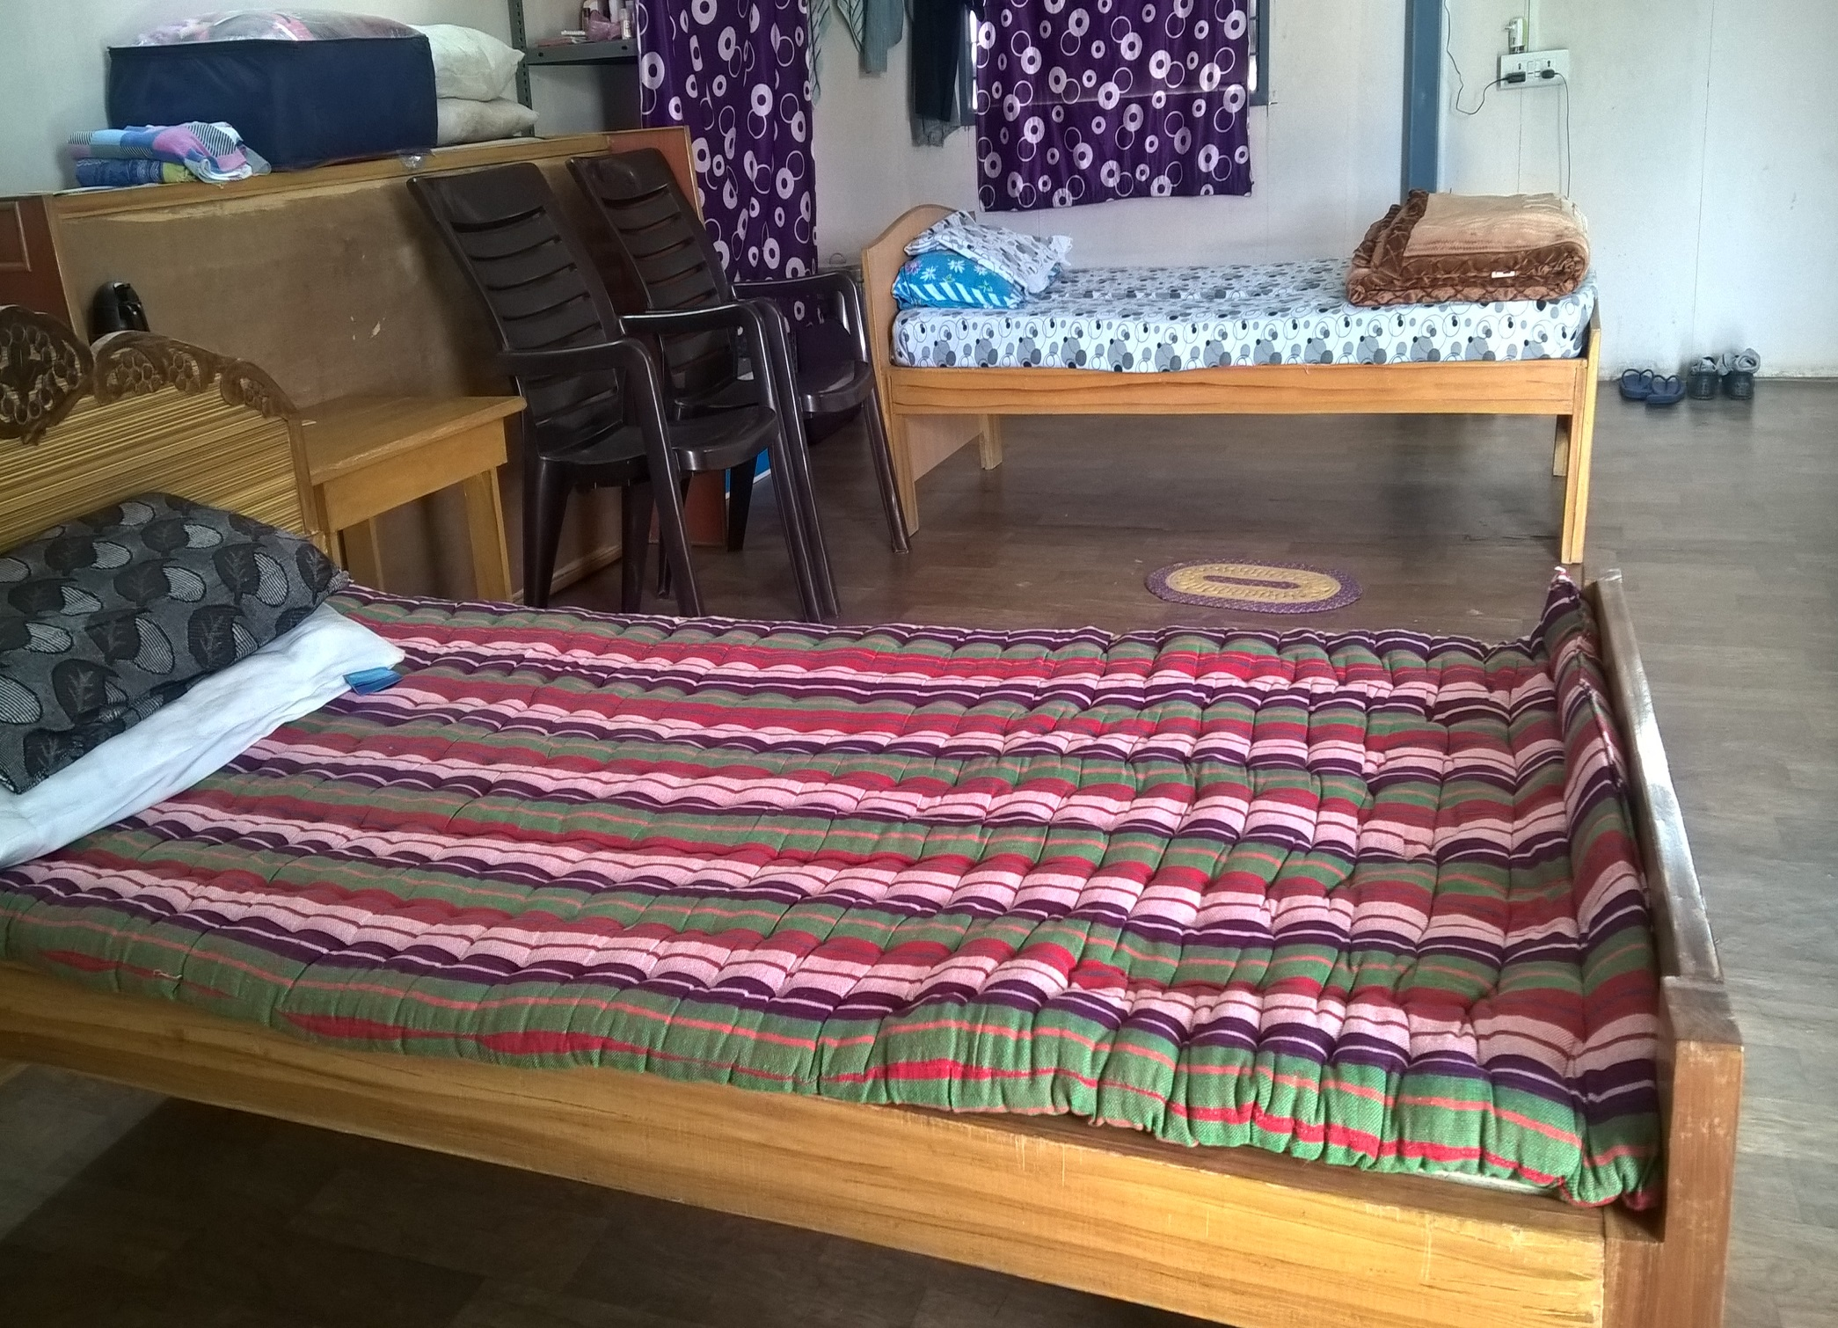
CAMP-EMPLOYEE ROOM INSIDE – Homely Feeling.

Slide 15
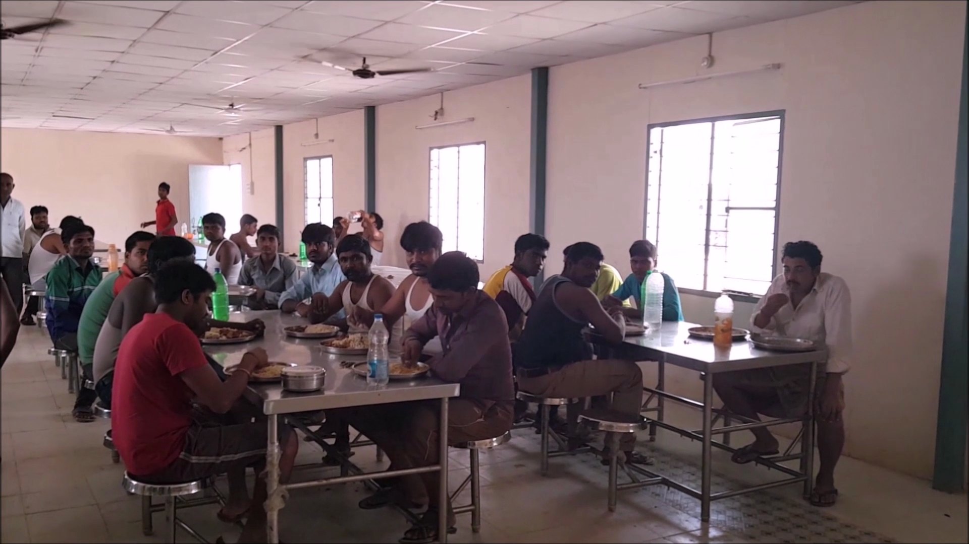
DINNING HALL – Nutritious food with Cleanliness.

Slide 16
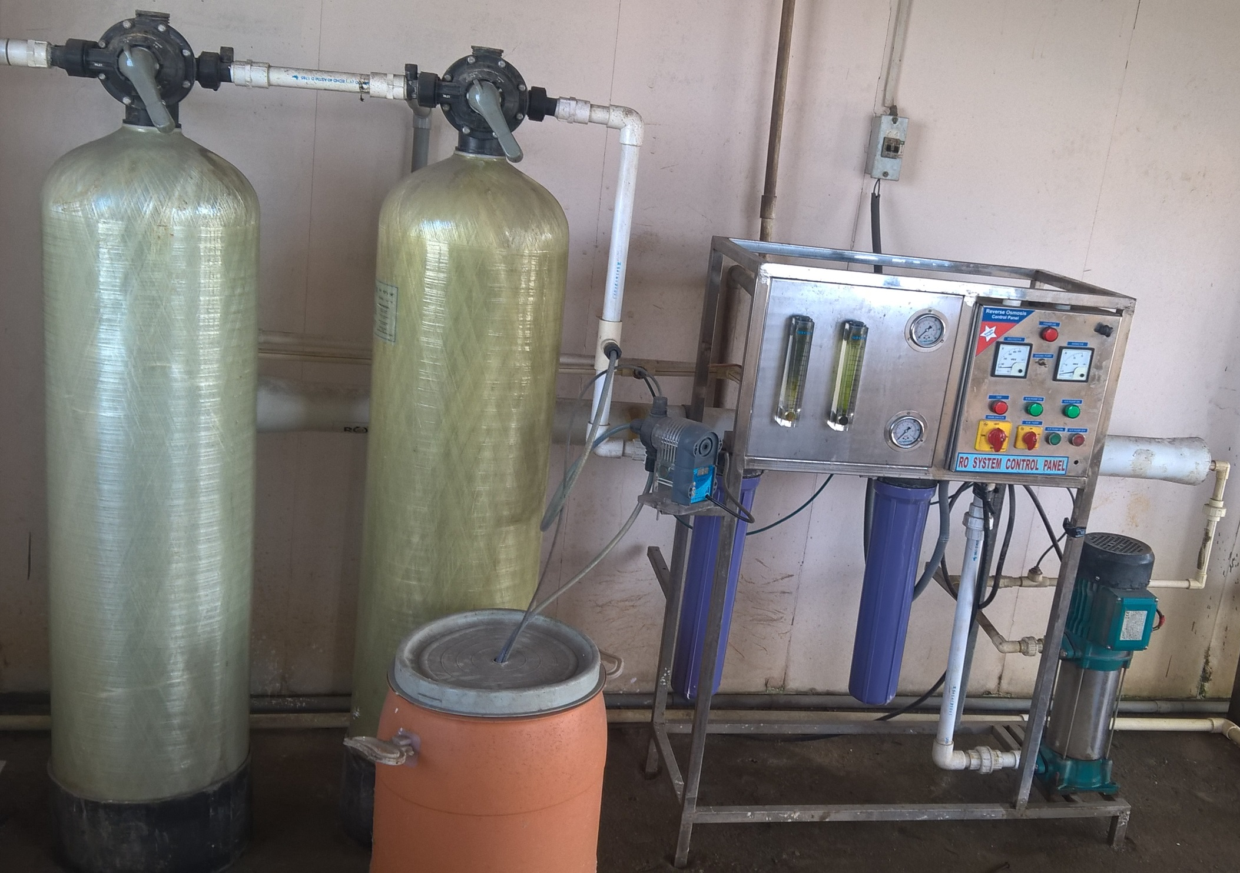
DRINKING WATER – A Dedicated “R.O” Plant.

Slide 17
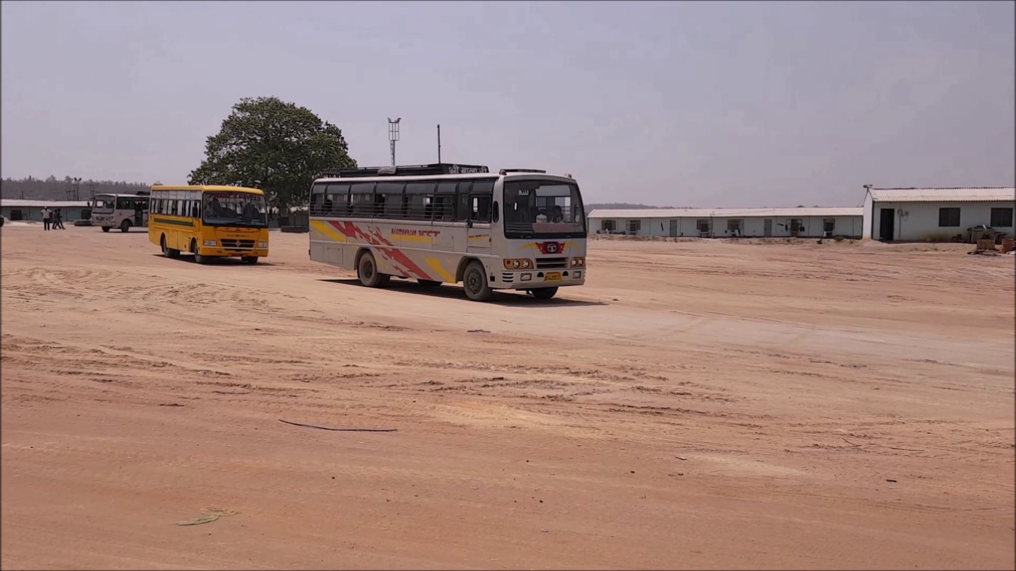
EMPLOYEE BUS – Always thinking about Employee.

Slide 18
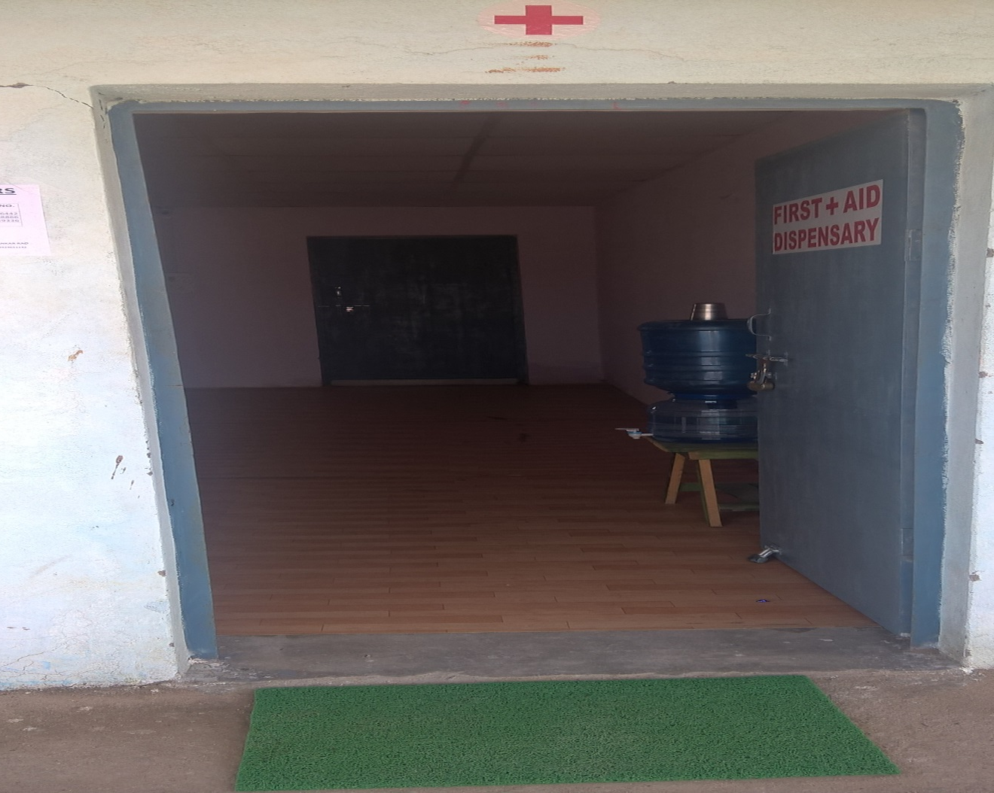
FIRST AID ROOM – Employee Welfare a Priority.

Slide 19
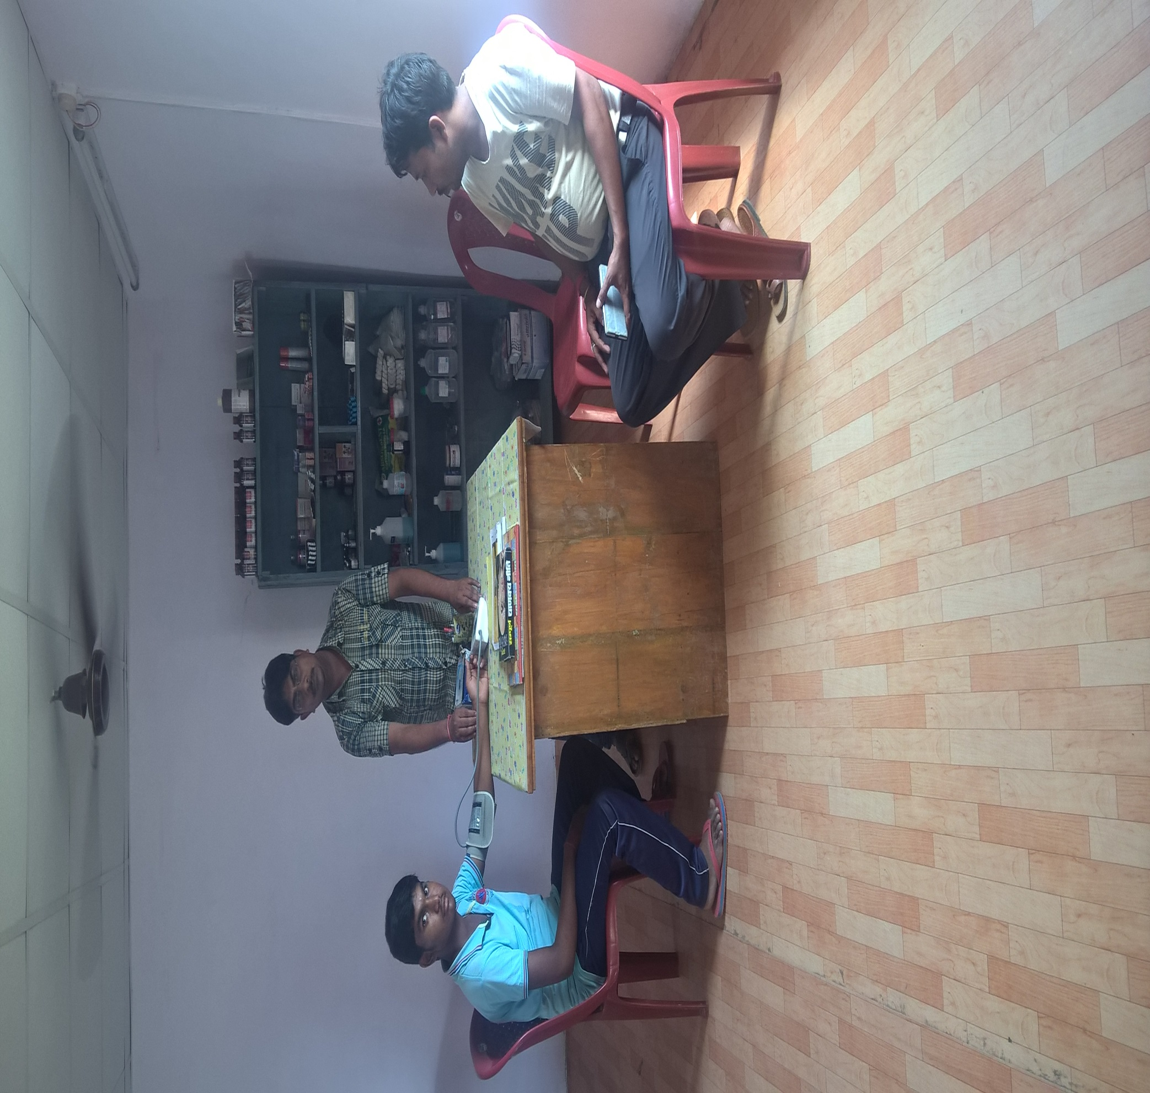
FIRST AID ROOM – Any unforeseen Incident , we are ready.

Slide 20
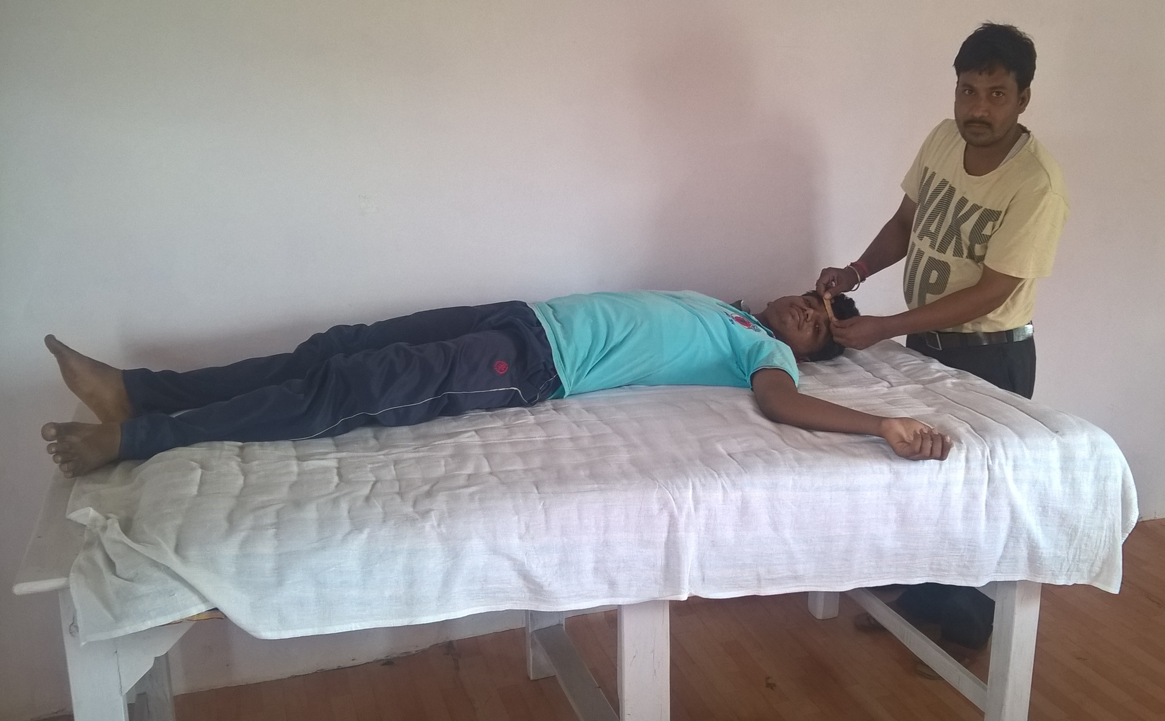
FIRST AID ROOM – Employee health is Paramount.

Slide 21
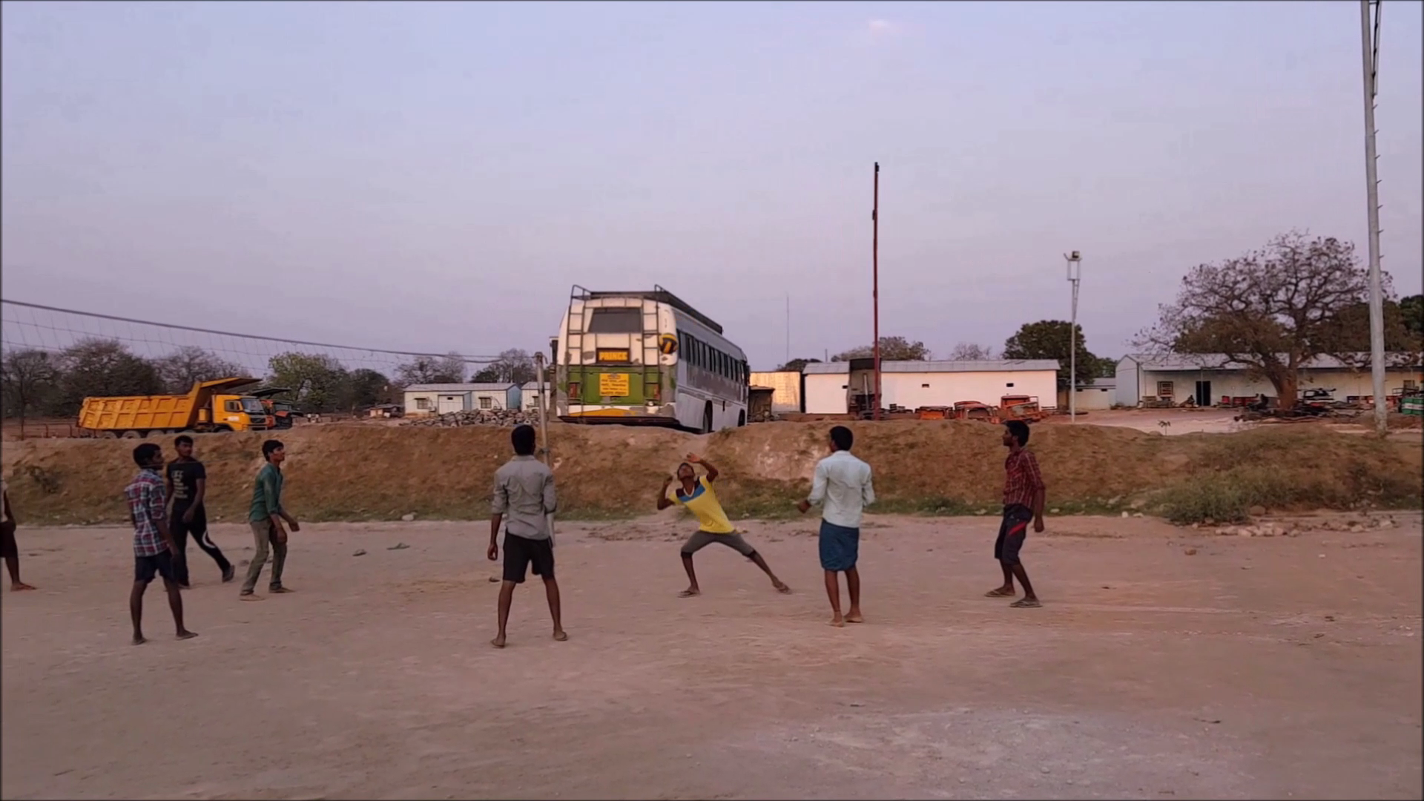
VOLLEYBALL COURT – Employee enjoy working at VPR

Slide 22
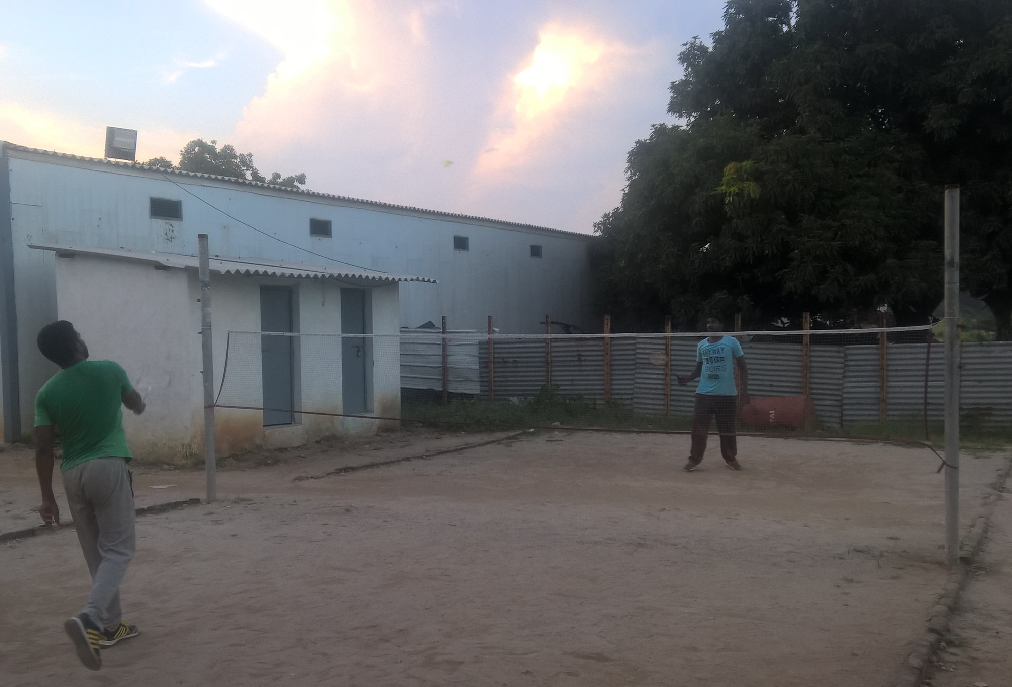
SHUTTLE COURT – Every one has talent in Sports.

Slide 23
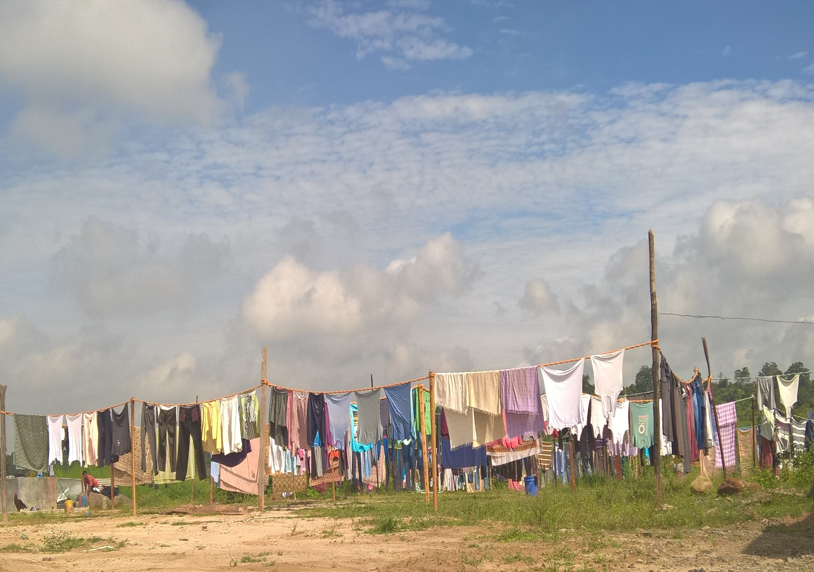
DEDICATED LAUNDRY FOR ALL EMPLOYEES.

Slide 24
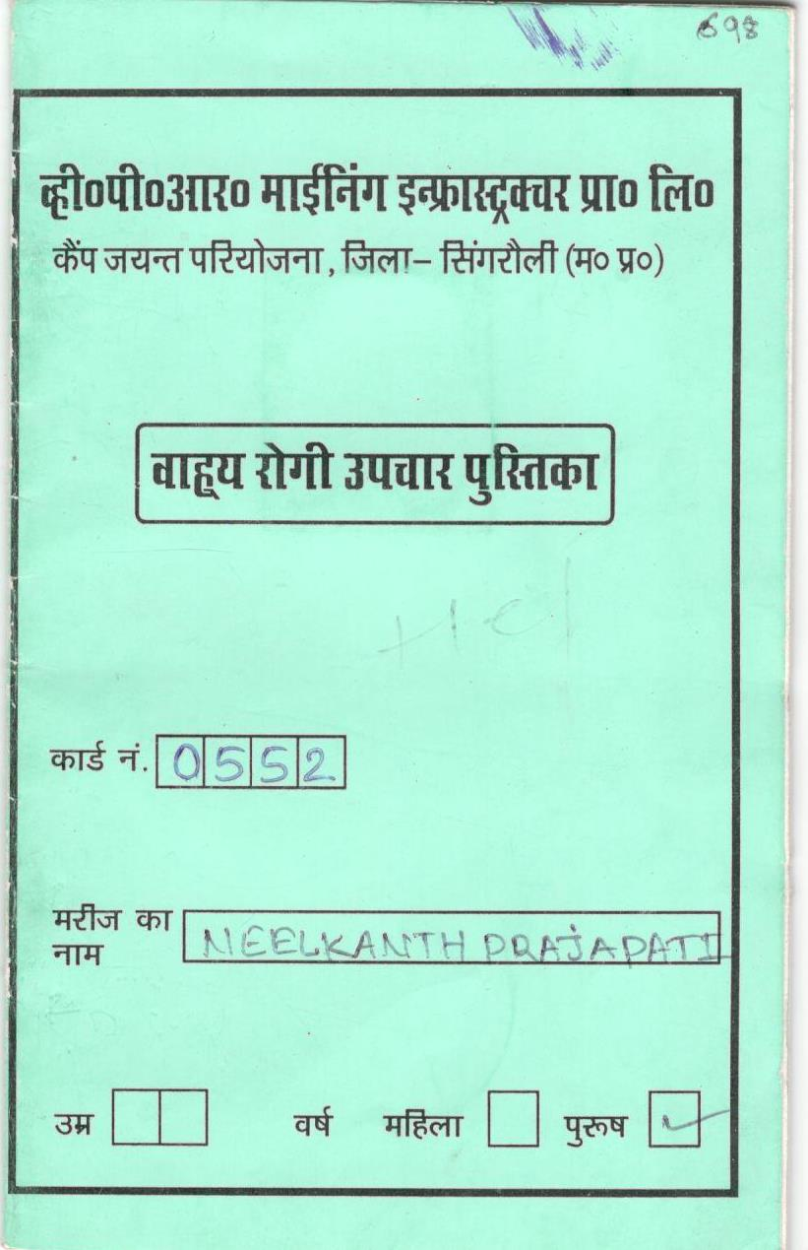
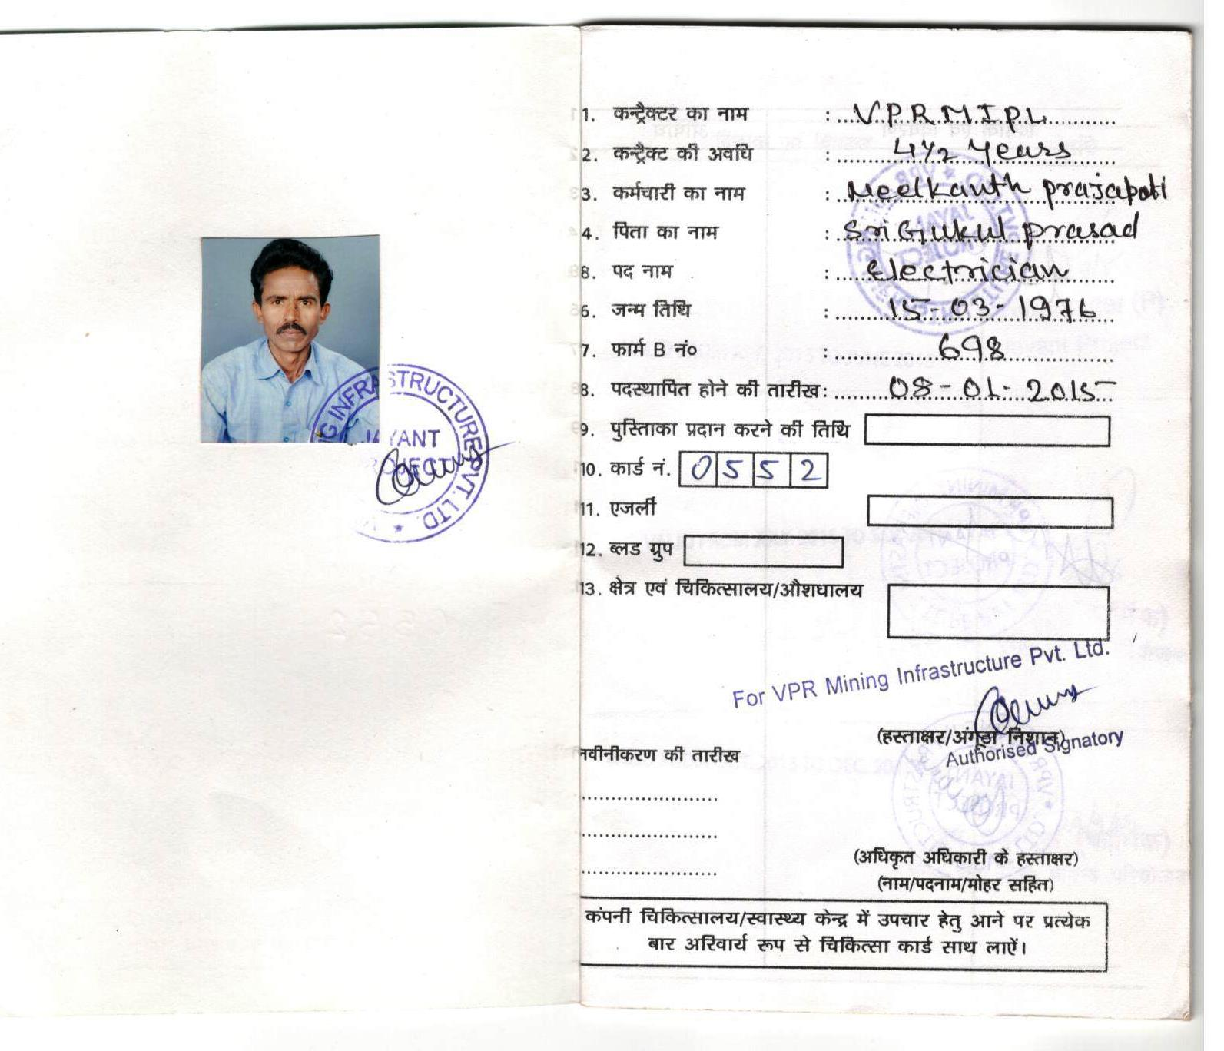
HEALTH CARD – At most care to Employee Health.
“When wealth is lost, nothing is lost; when health is lost, something is lost”
-Billy Graham

Slide 25
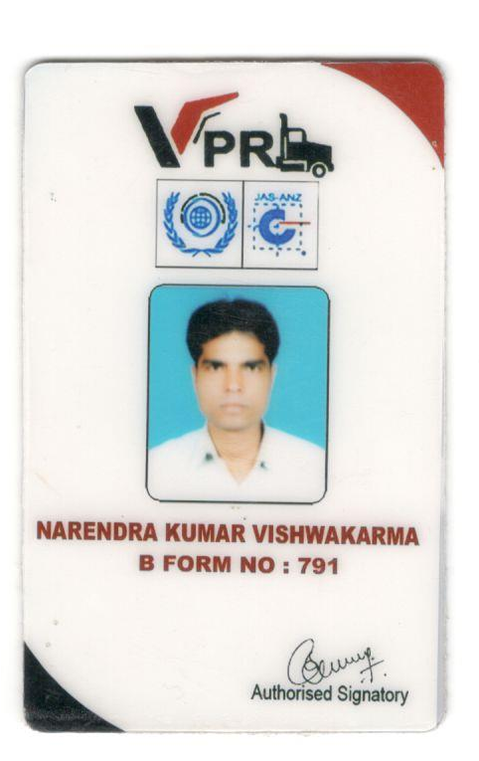
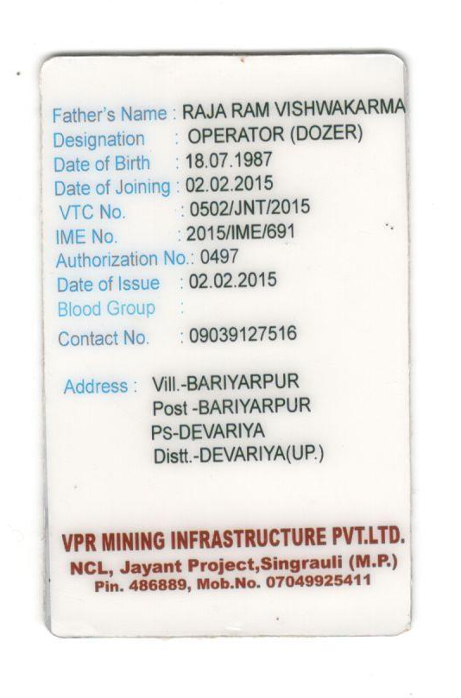
Identity Card – If you are at VPR , its an identity in Mining .

Slide 26
SAFETY - FIRST
NCL-MISSION
“The mission of Northern Coalfields Limited is to produce and market the planned quantity of coal and coal products efficiently and economically with due regard to safety, conservation, quality and environment”.
VPRMIPL IS SUPPORTING TO ACHIEVE NCL’S MISSION

Slide 27
Basic Safety Orientation Training
Confined Space
Fire / Fire Extinguishers
Basic First Aid (not certified training)
Heat/Cold Stress
Good Safety Practices
Hazard Communication
Respirators
Personal Protective Equipment
Hearing Conservation
Fall Protection
Lockout Tag out

Slide 28

VPR SAFETY PRACTICES AT OUR SITES
SAFETY FOR INDIVIDUAL(PERSONAL PROTECTIVE EQUIPMENTS)
SAFETY FOR EACH SECTION(SERVICE AREA, WELDING ETC)
SAFETY CONFERENCE RECOMMENDATIONS
CODE OF PRACTICE FOR DUMPING ETC
MAINTENANCE OF HAUL ROADS
REPAIR AND OVER HAUL OF HEMM
TRAINING OF OPERATORS/DRIVERS

Slide 29
GOOD SAFETY PRACTICES VPR MINING
Inspect work area daily
Be an observer - stay alert
Housekeeping, Housekeeping,Housekeeping
Use your best safety device - THINK
If you’re not sure - ASK someone!!
Report Injuries/Incidents/Illnesses
Report safety issues to the safety committee

Slide 30
The P.A.S.S. Methodthod
FIRE SAFETY TRAINING AT ALL SITES
CLASS | TYRE OF FIRE | SYMBOL
CLASS A Ordinary Combustibles | This includes fuels such as wood, paper, plastic, rubber, and cloth.
Class B or Flammable and Combustible Liquids and Gases | This includes all hydrocarbon and alcohol based liquids and gases that will support combustion.
Class C or Electrical | This includes all fires involving energized electrical equipment
Squeeze the lever.
Pull the pin.
Aim the hose
or nozzle.
Sweep the
agent.

Slide 31
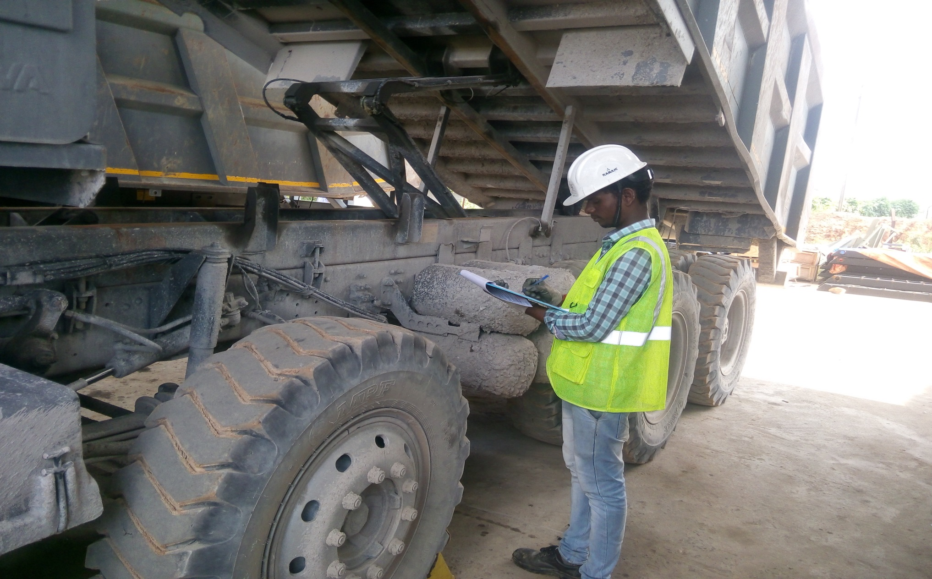
SAFETY AT TRUCK MAINTENANCE - ENSURED

Slide 32
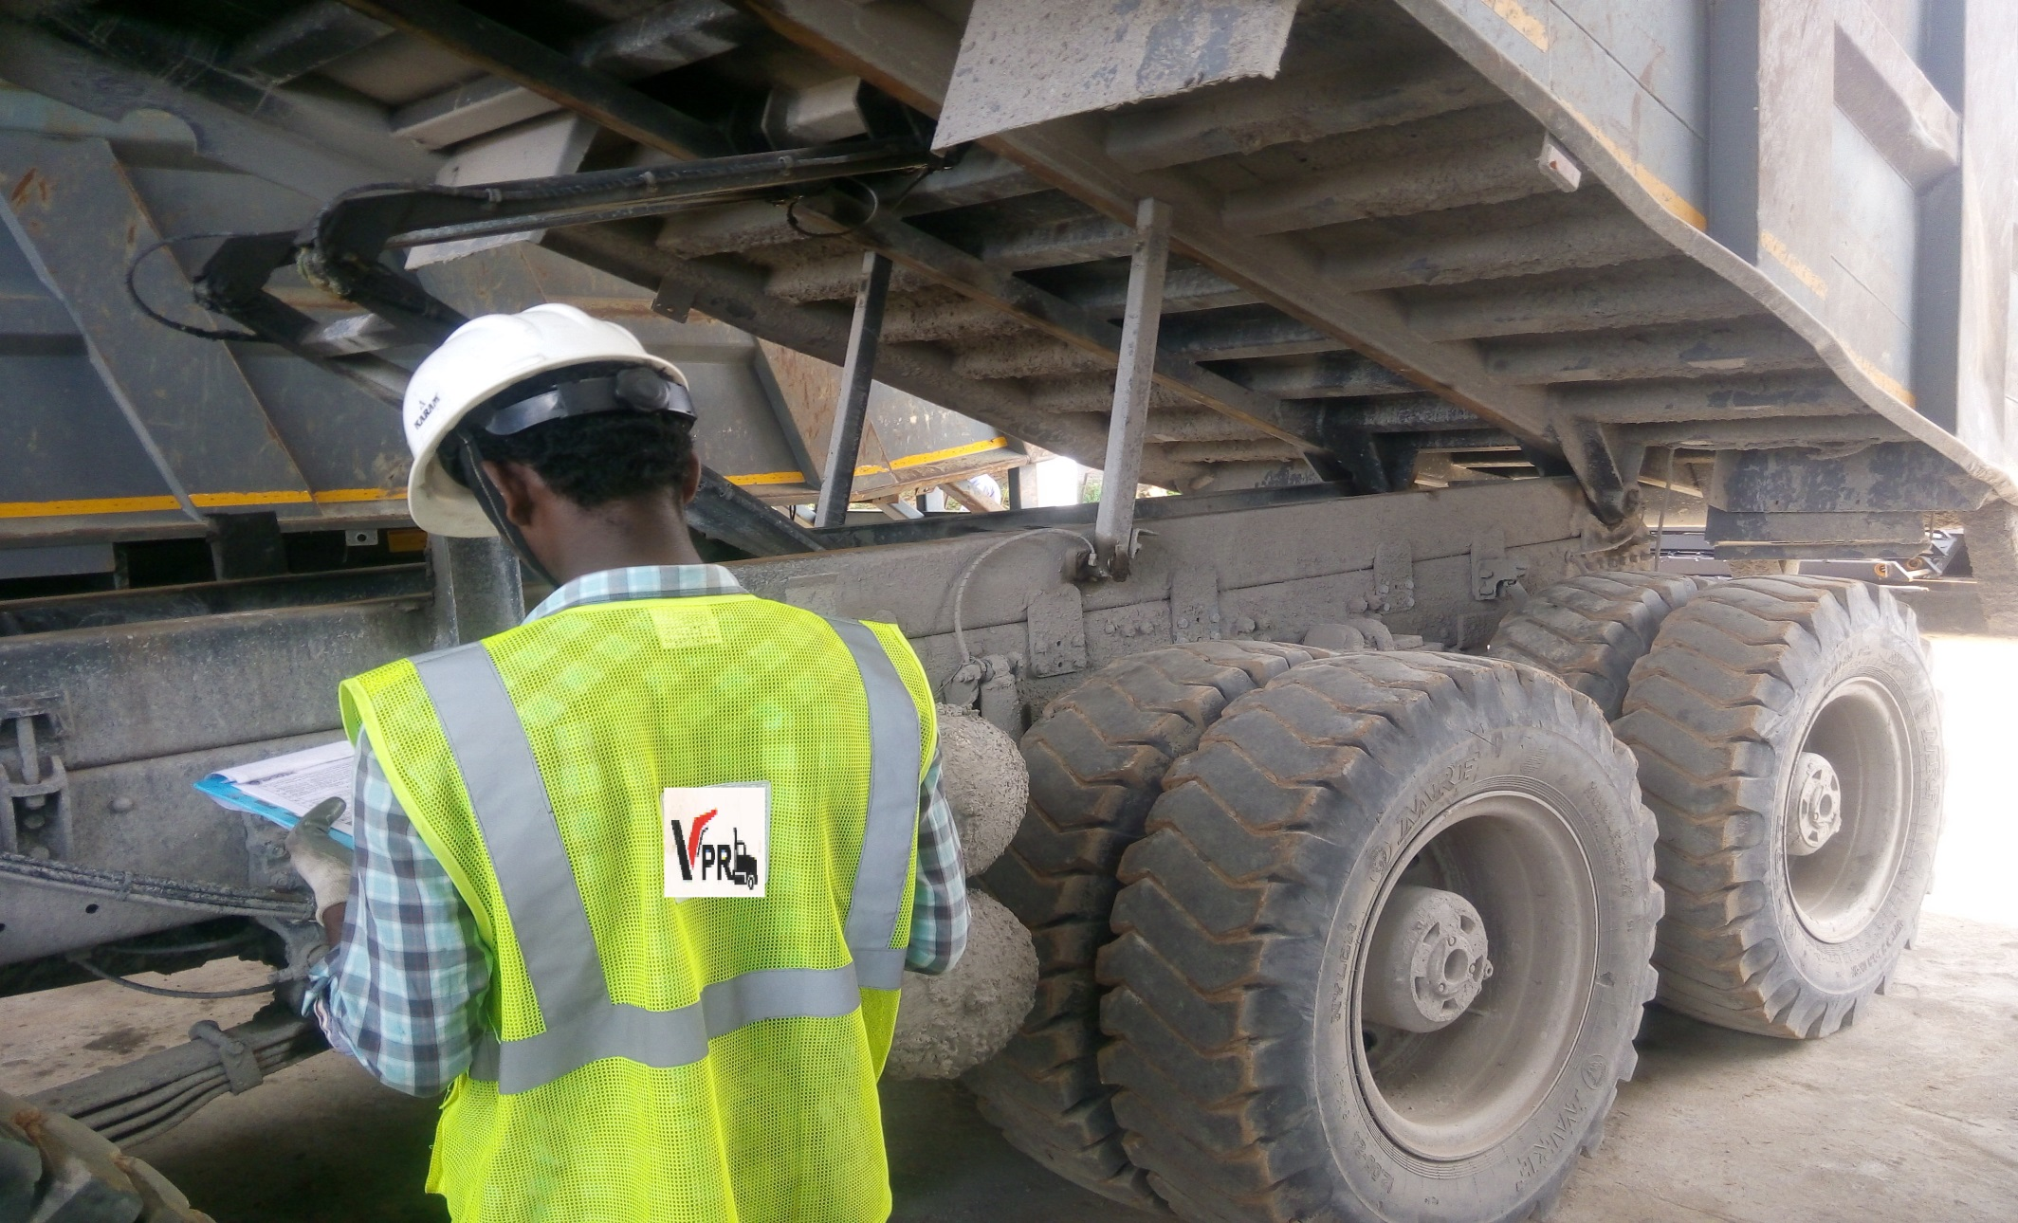
SAFETY AT TRUCK MAINTENANCE – IS A MUST
Safety Jacket

Slide 33
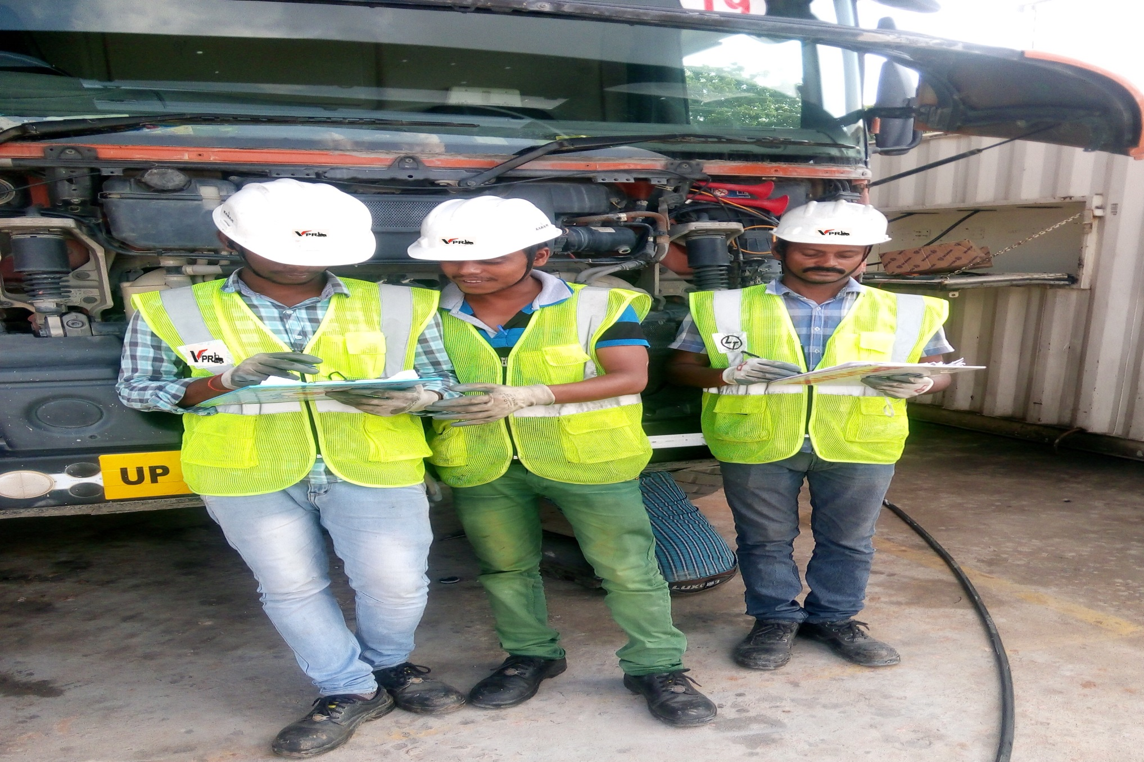
SAFETY AT TRUCK MAINTENANCE – NO COMPROMISE
Safety Helmet
Safety Gloves
Safety Shoe

Slide 34
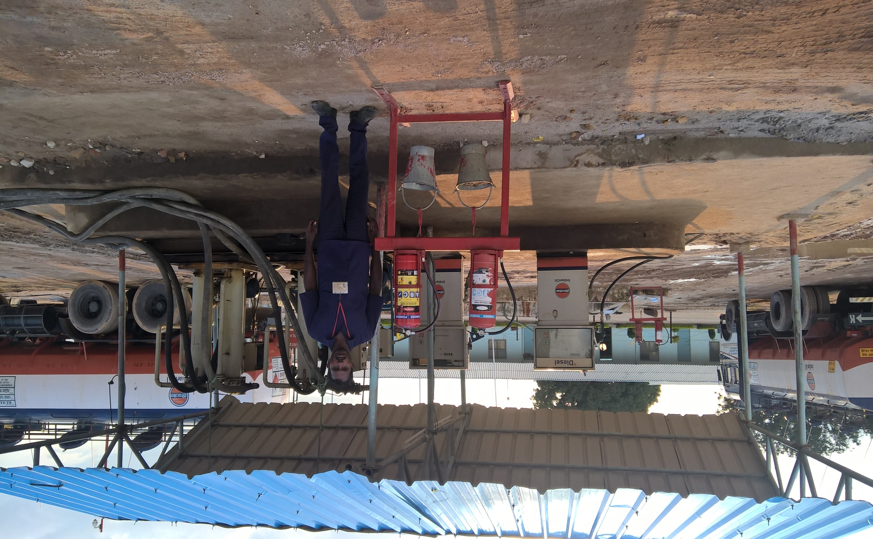
SAFETY AT CAMP-DIESEL SECTION - ATTENTION

Slide 35
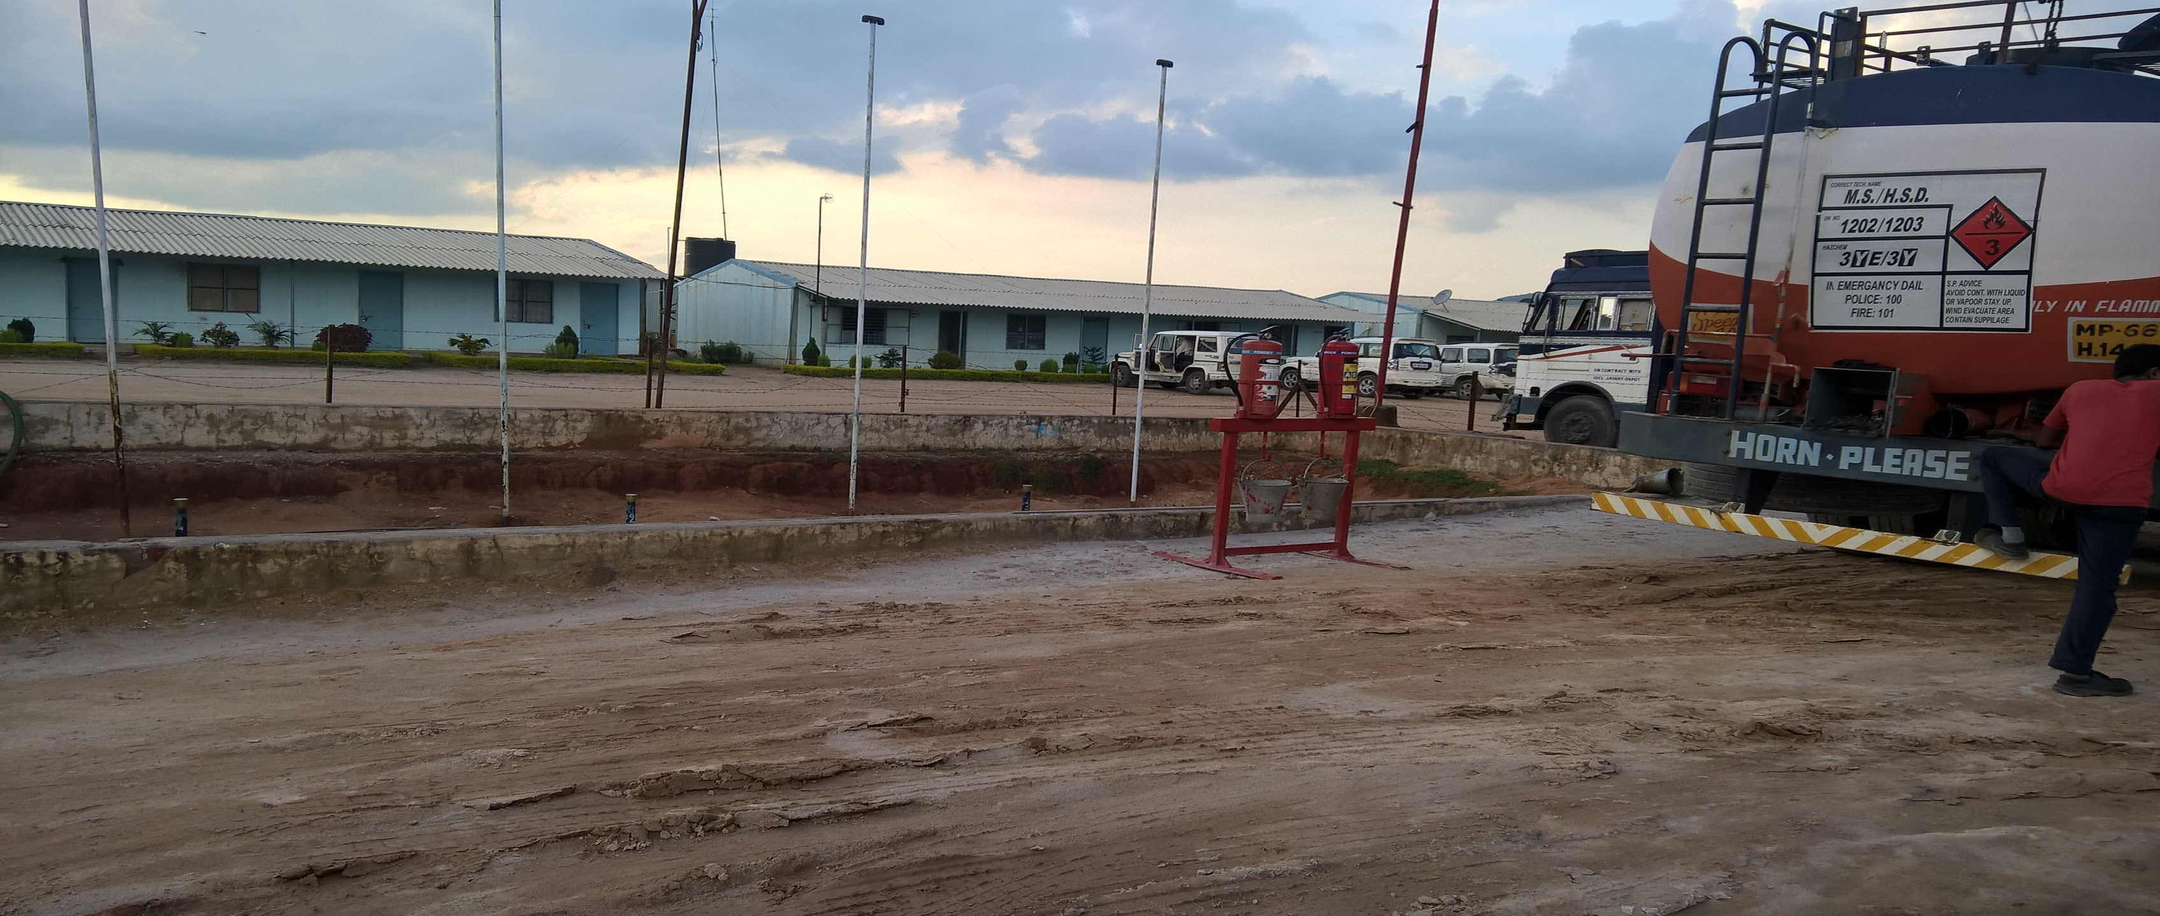
SAFETY AT CAMP-DIESEL SECTION – NO EXCUSES

Slide 36
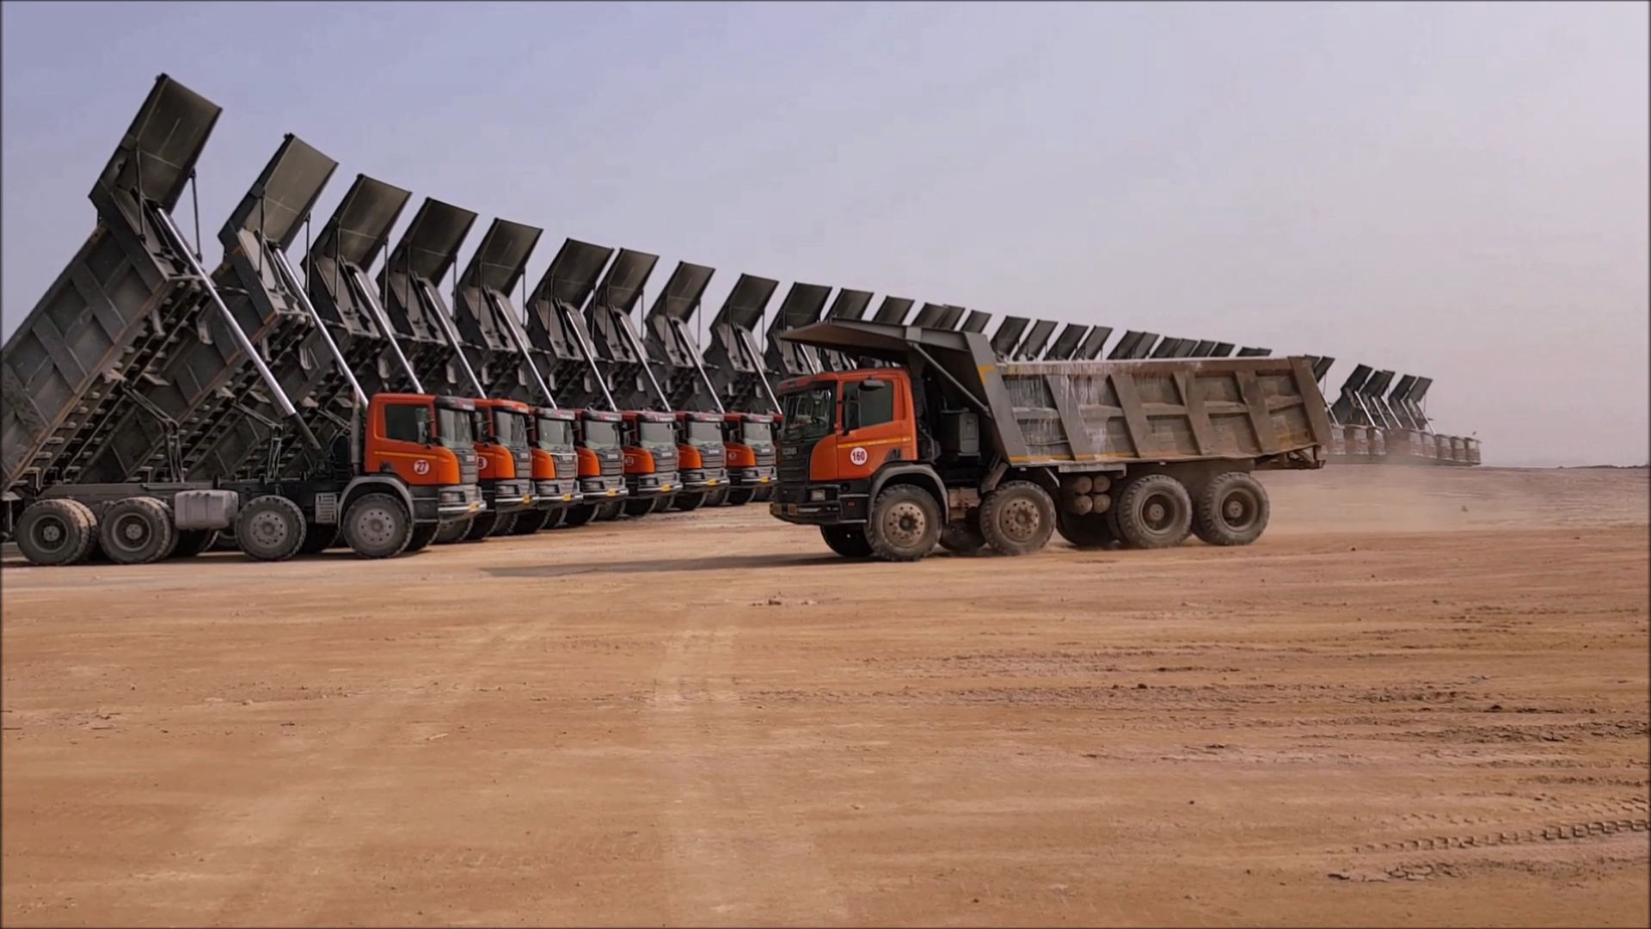
SITE SAFETY – MATICULOUS PLANNING

Slide 37
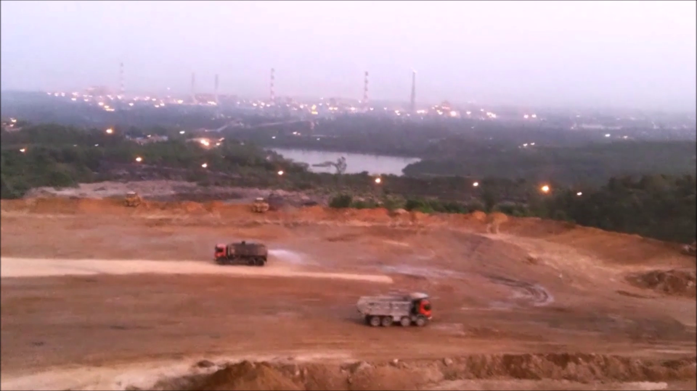
SAFETY AT SITE-WATER SPRINCKLING – SUPPRESSION OF DUST

Slide 38
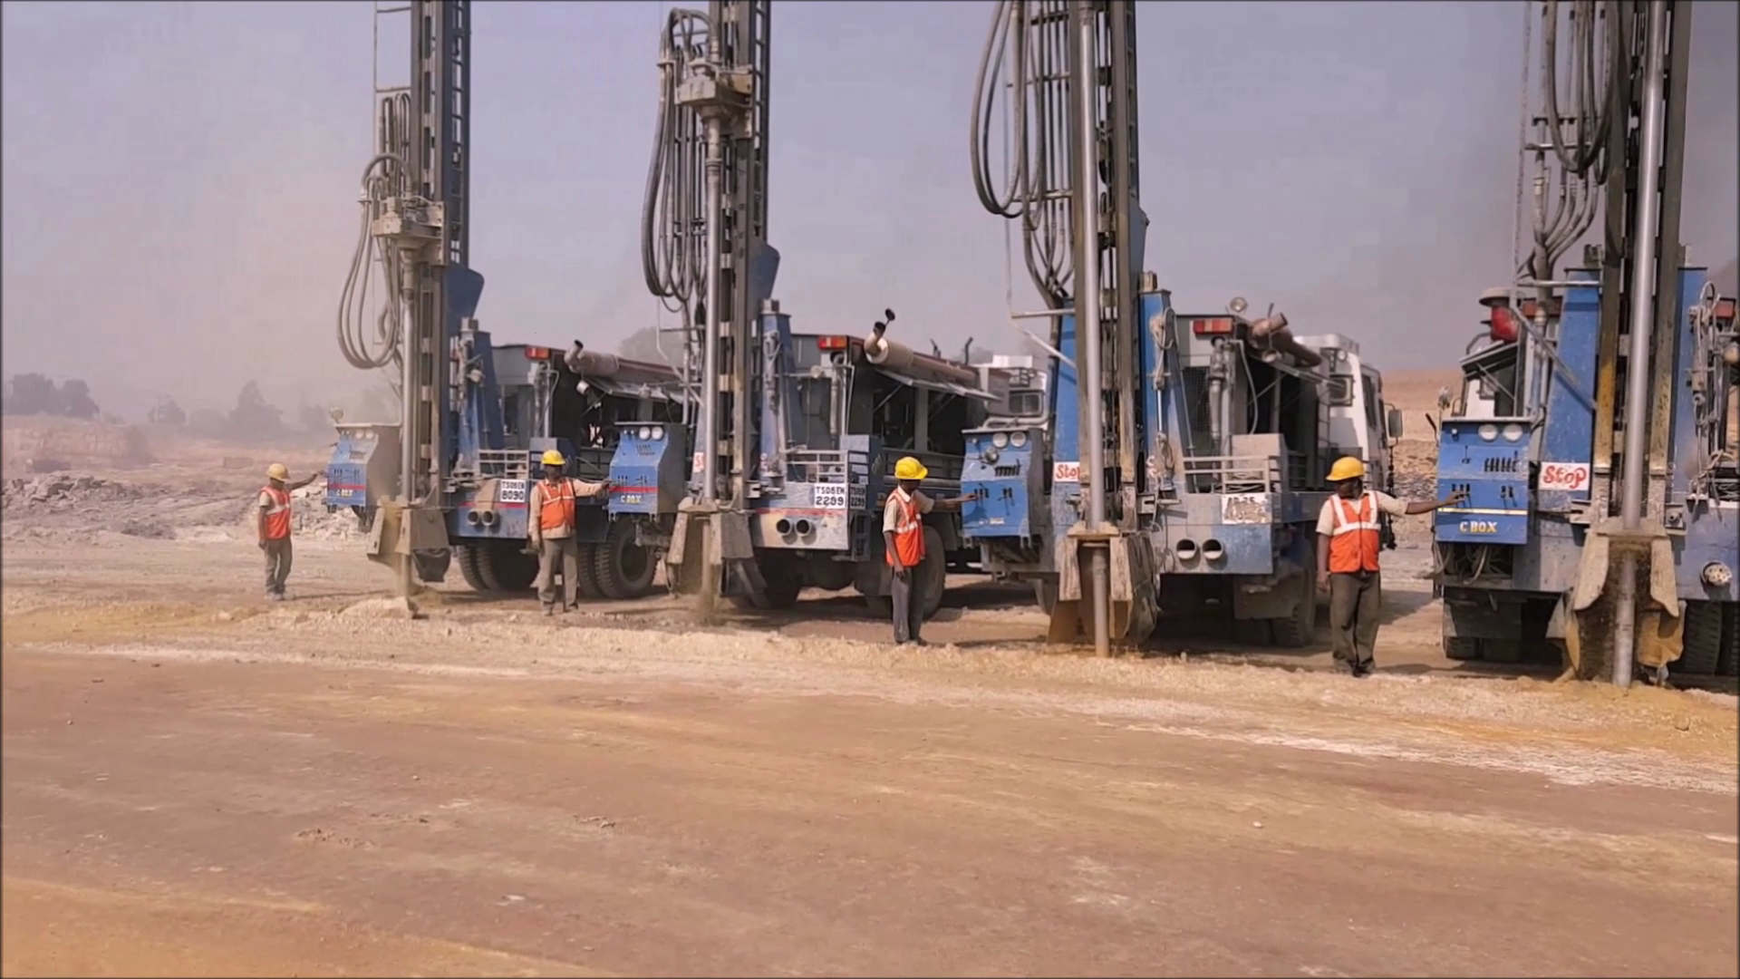
SITE SAFETY-DRILLING SECTION – ALWAYS ATTENTIVE

Slide 39
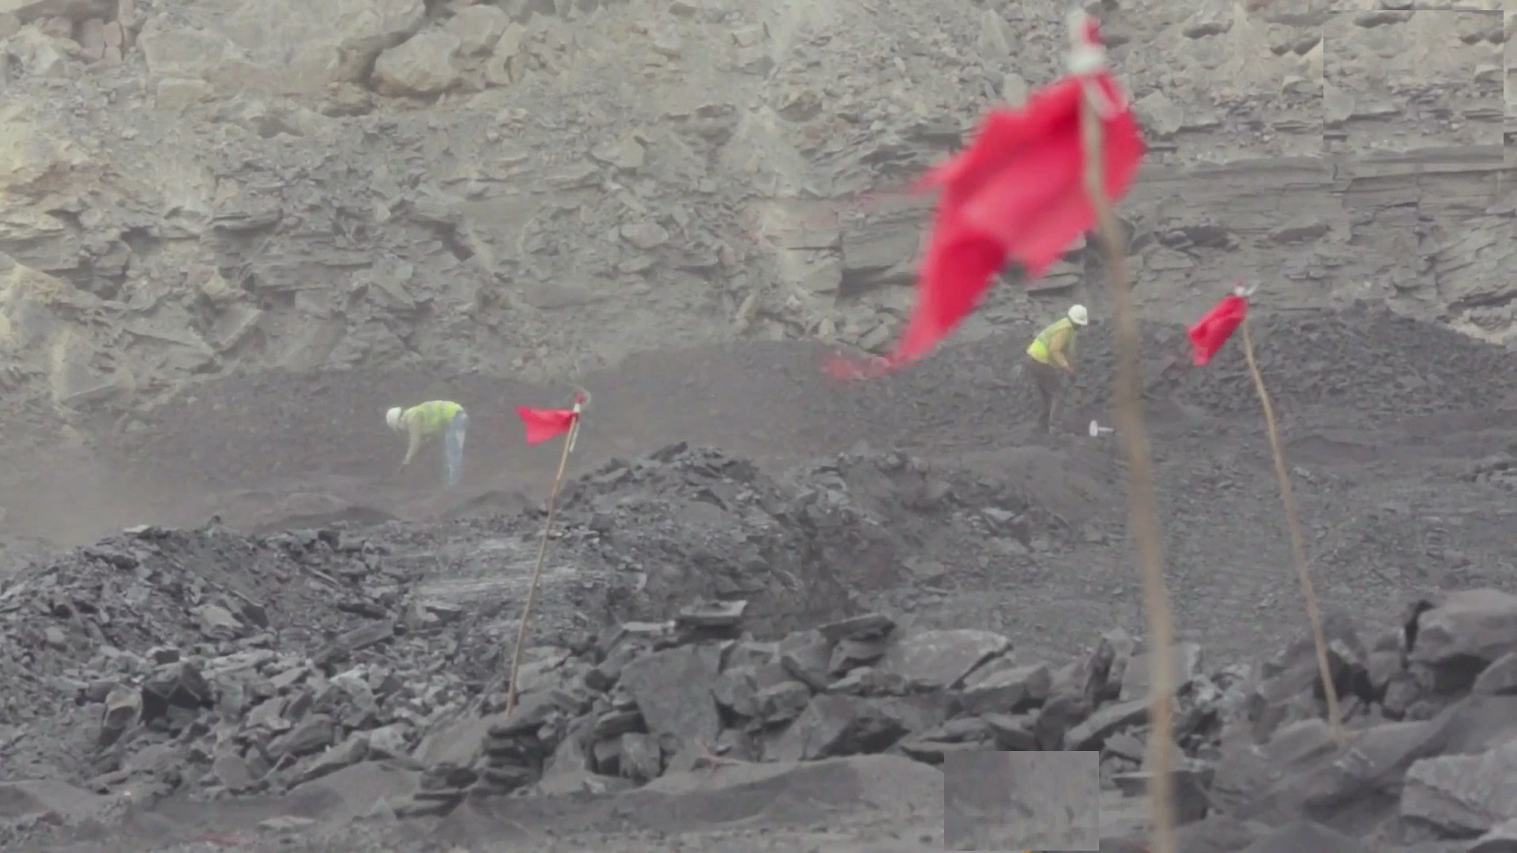
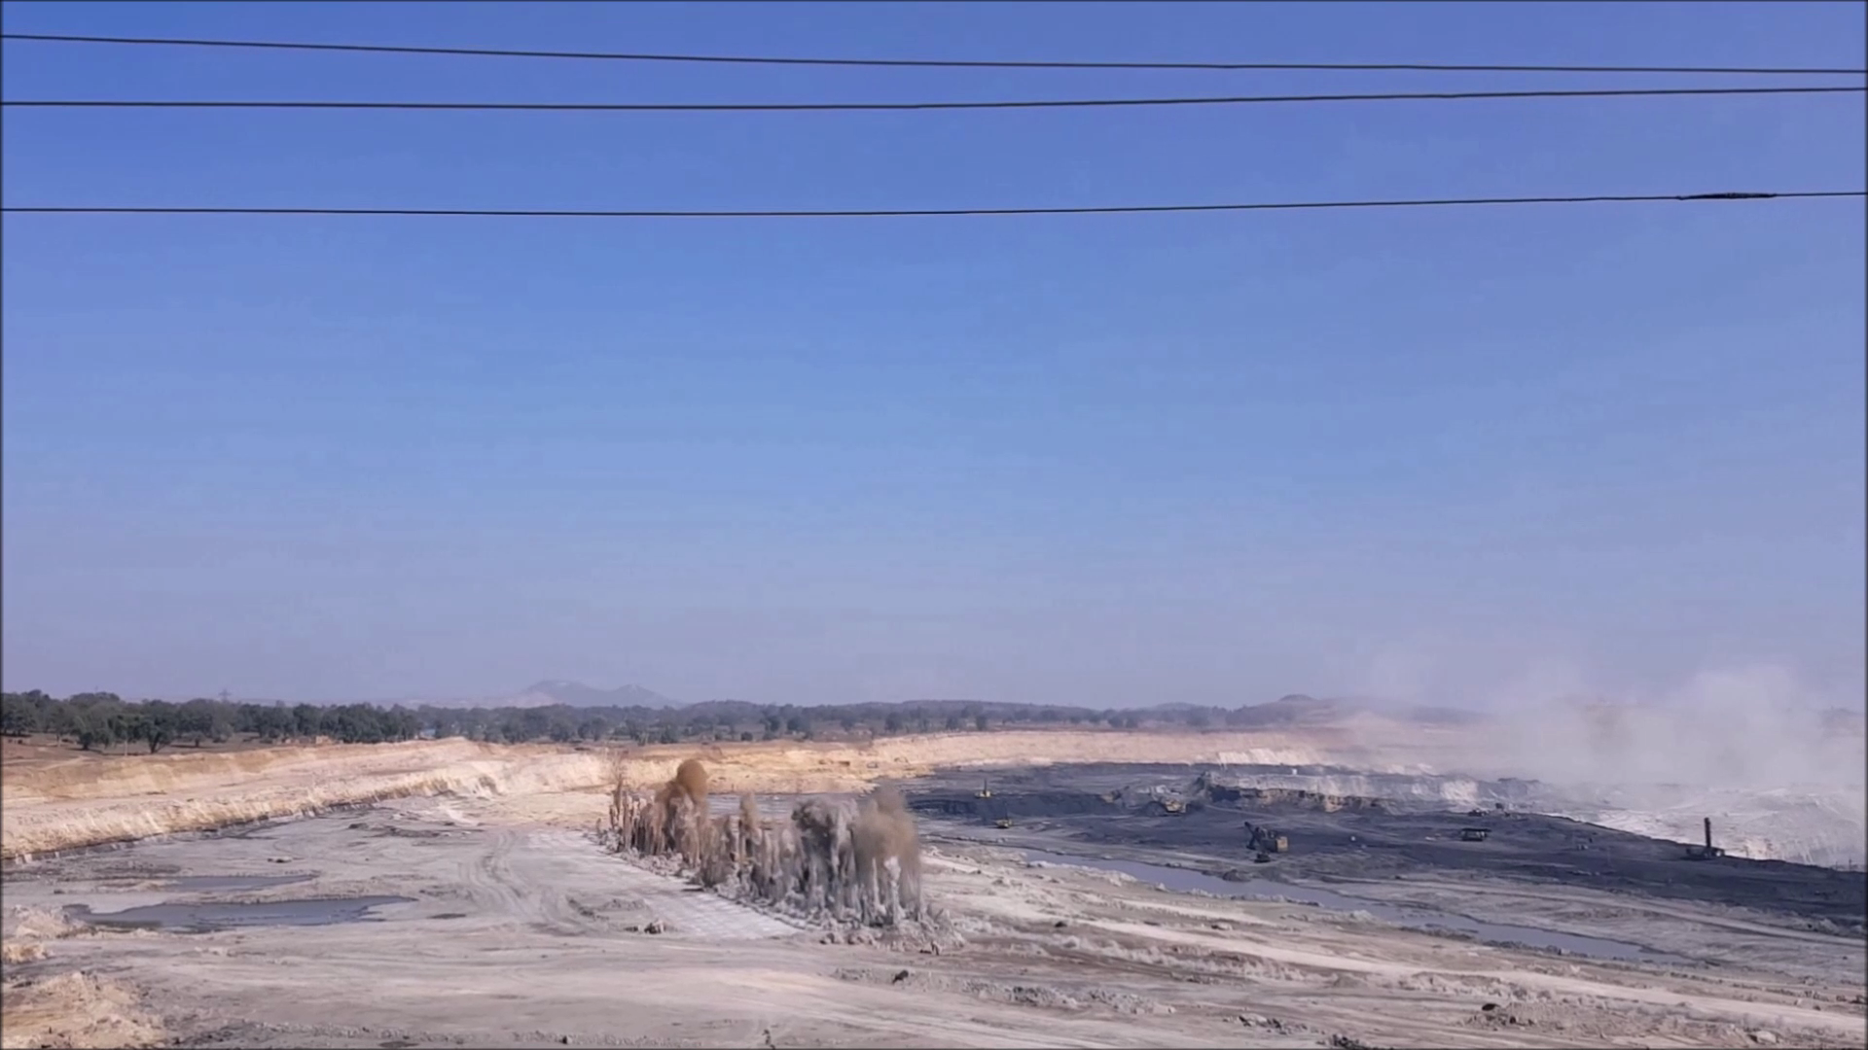
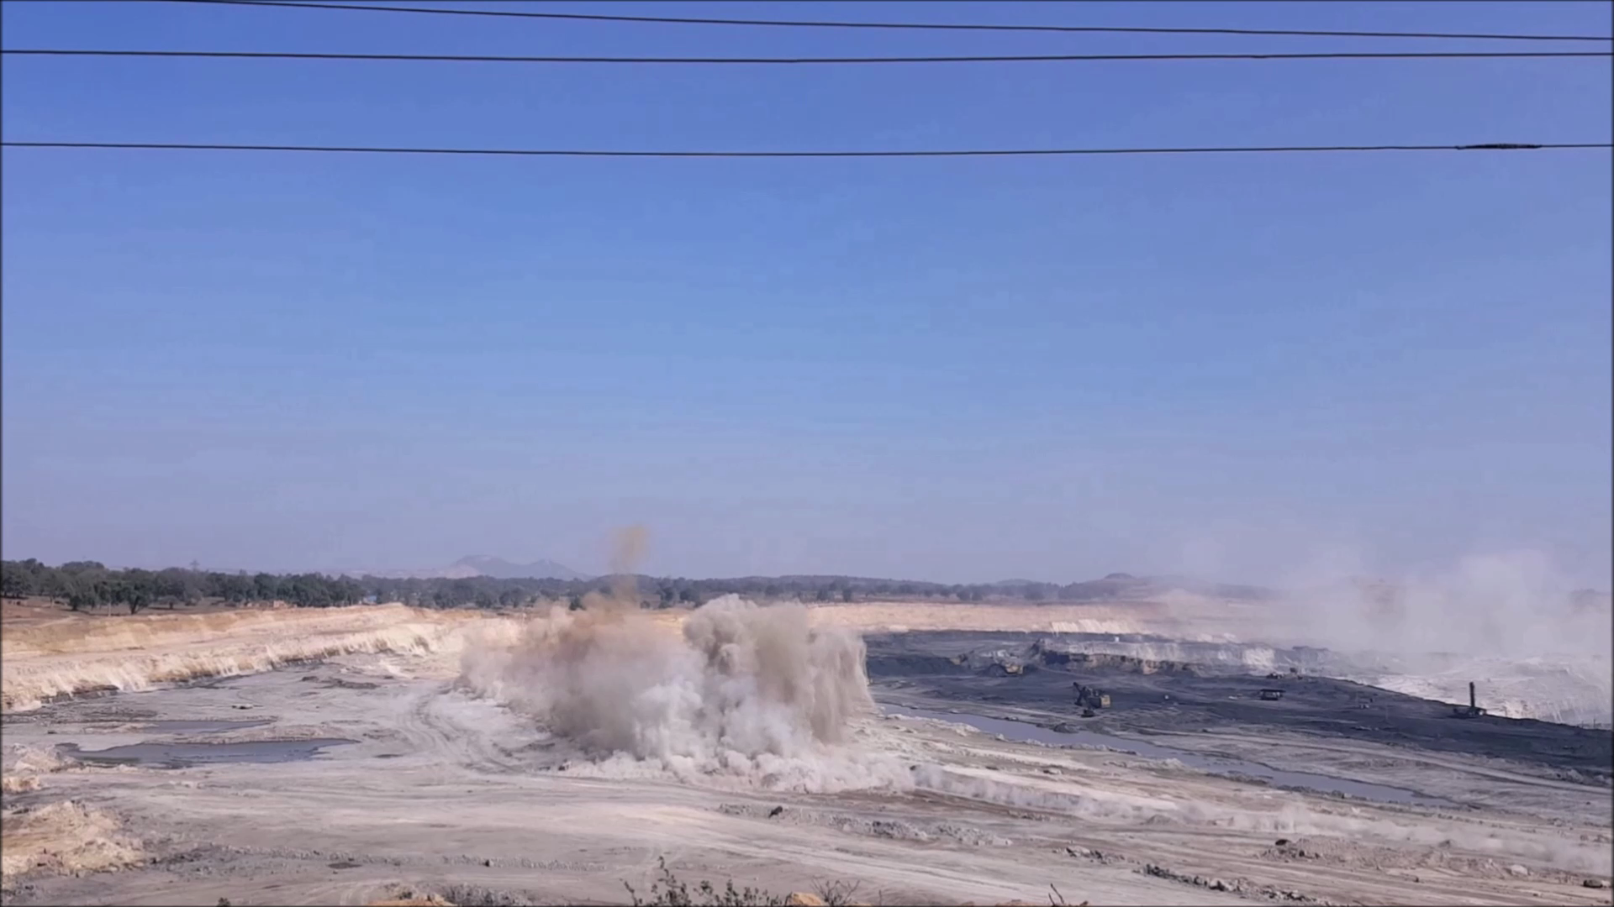
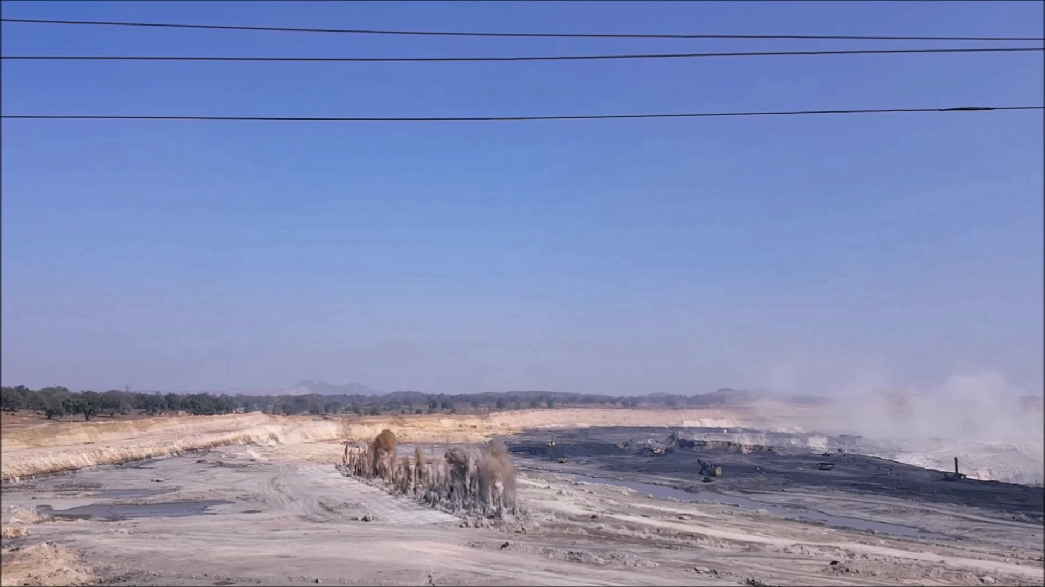
SITE SAFETY-BLASTING SECTION

Slide 40
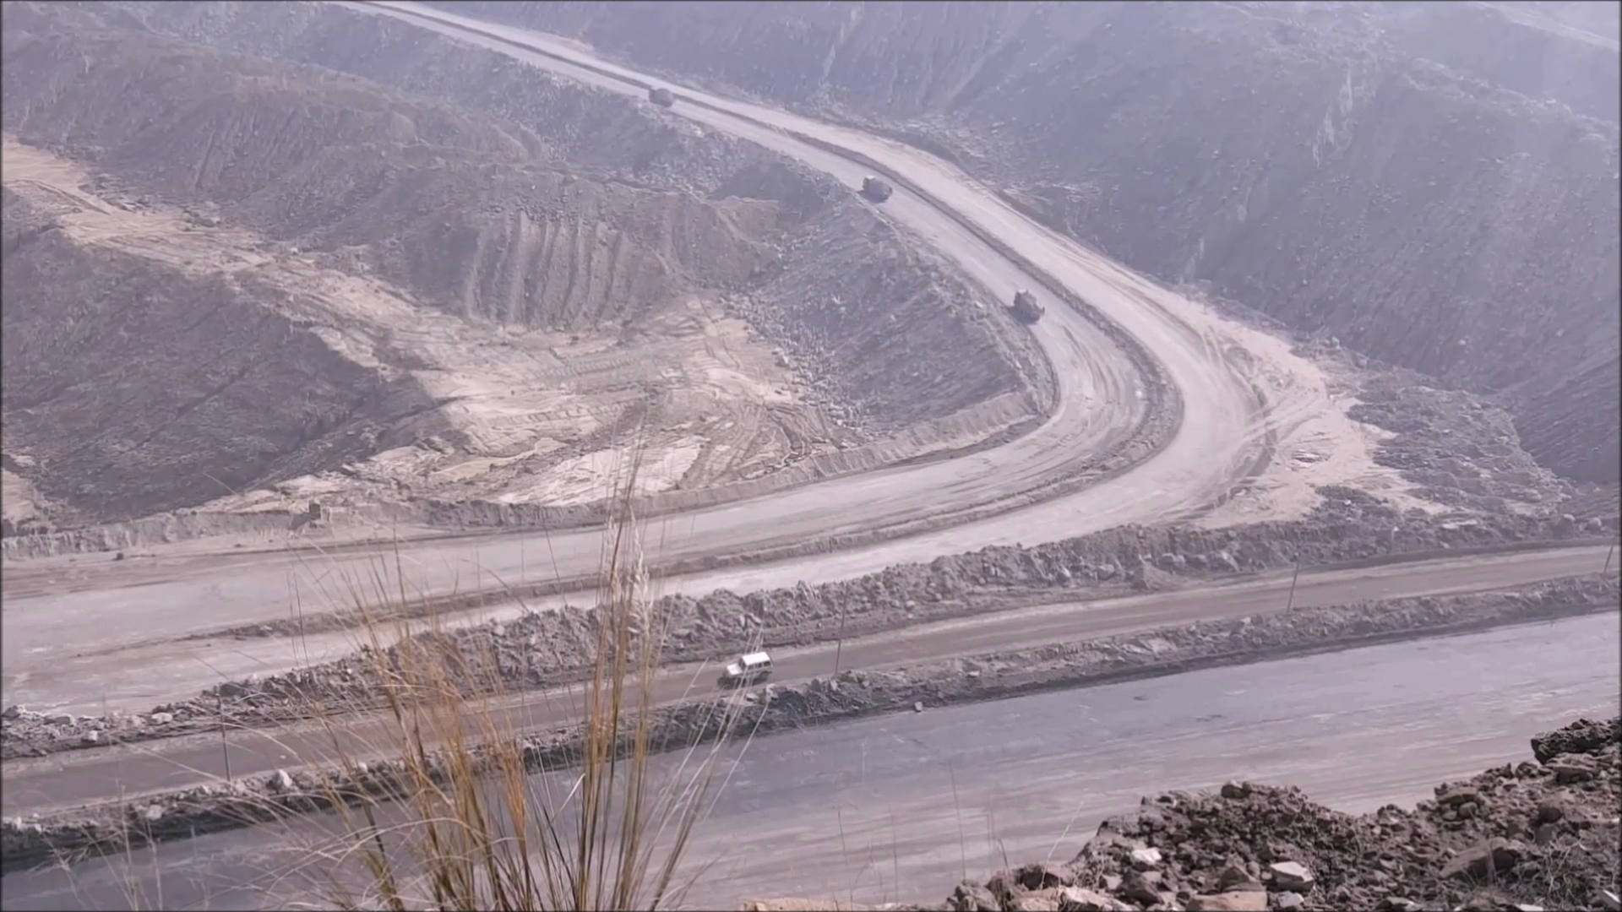
MAINTENANCE OF HAUL ROADS – You can’t see better than this.

Slide 41
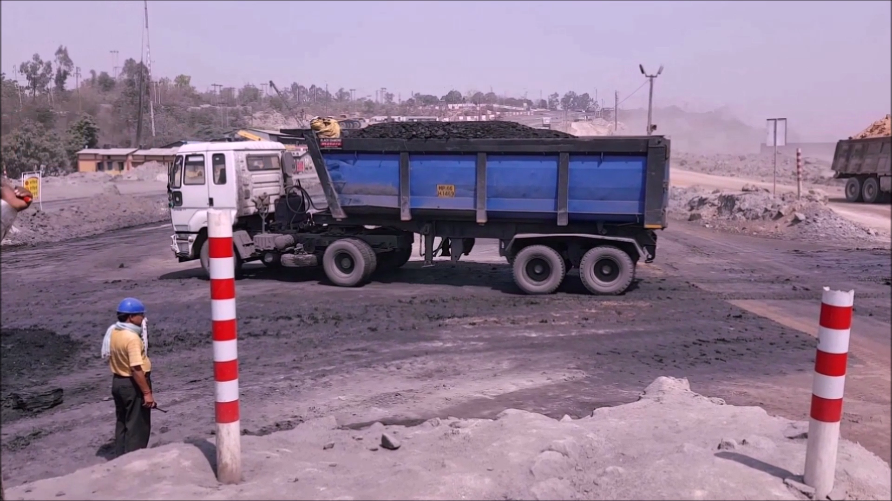
SITE SAFETY – Coal Carrier Junction , Always Guarded.

Slide 42
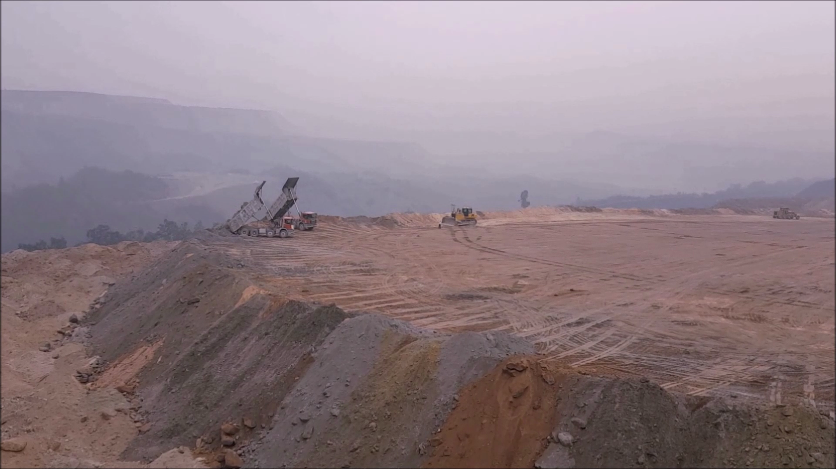
SITE SAFETY-DUMPING YARD – No Potholes , even surface.

Slide 43
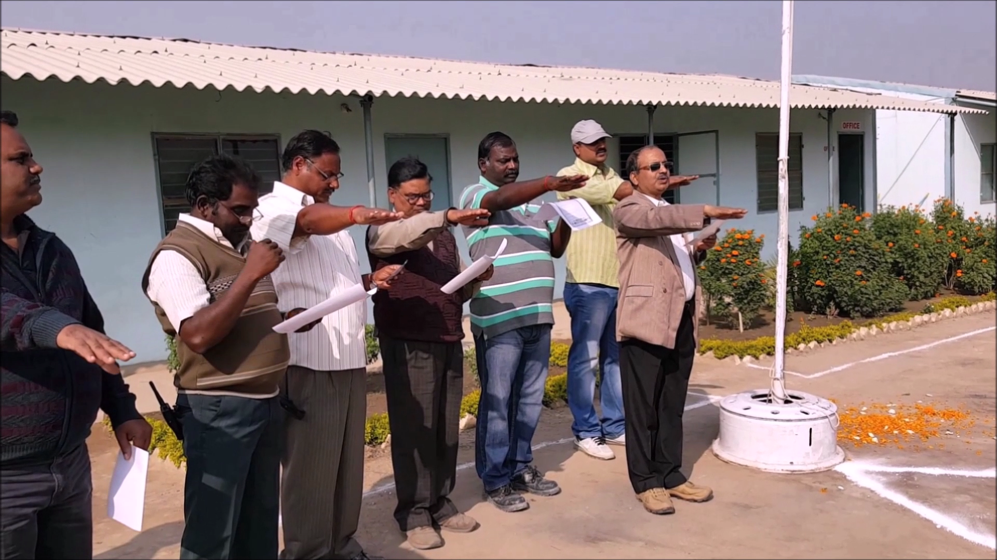
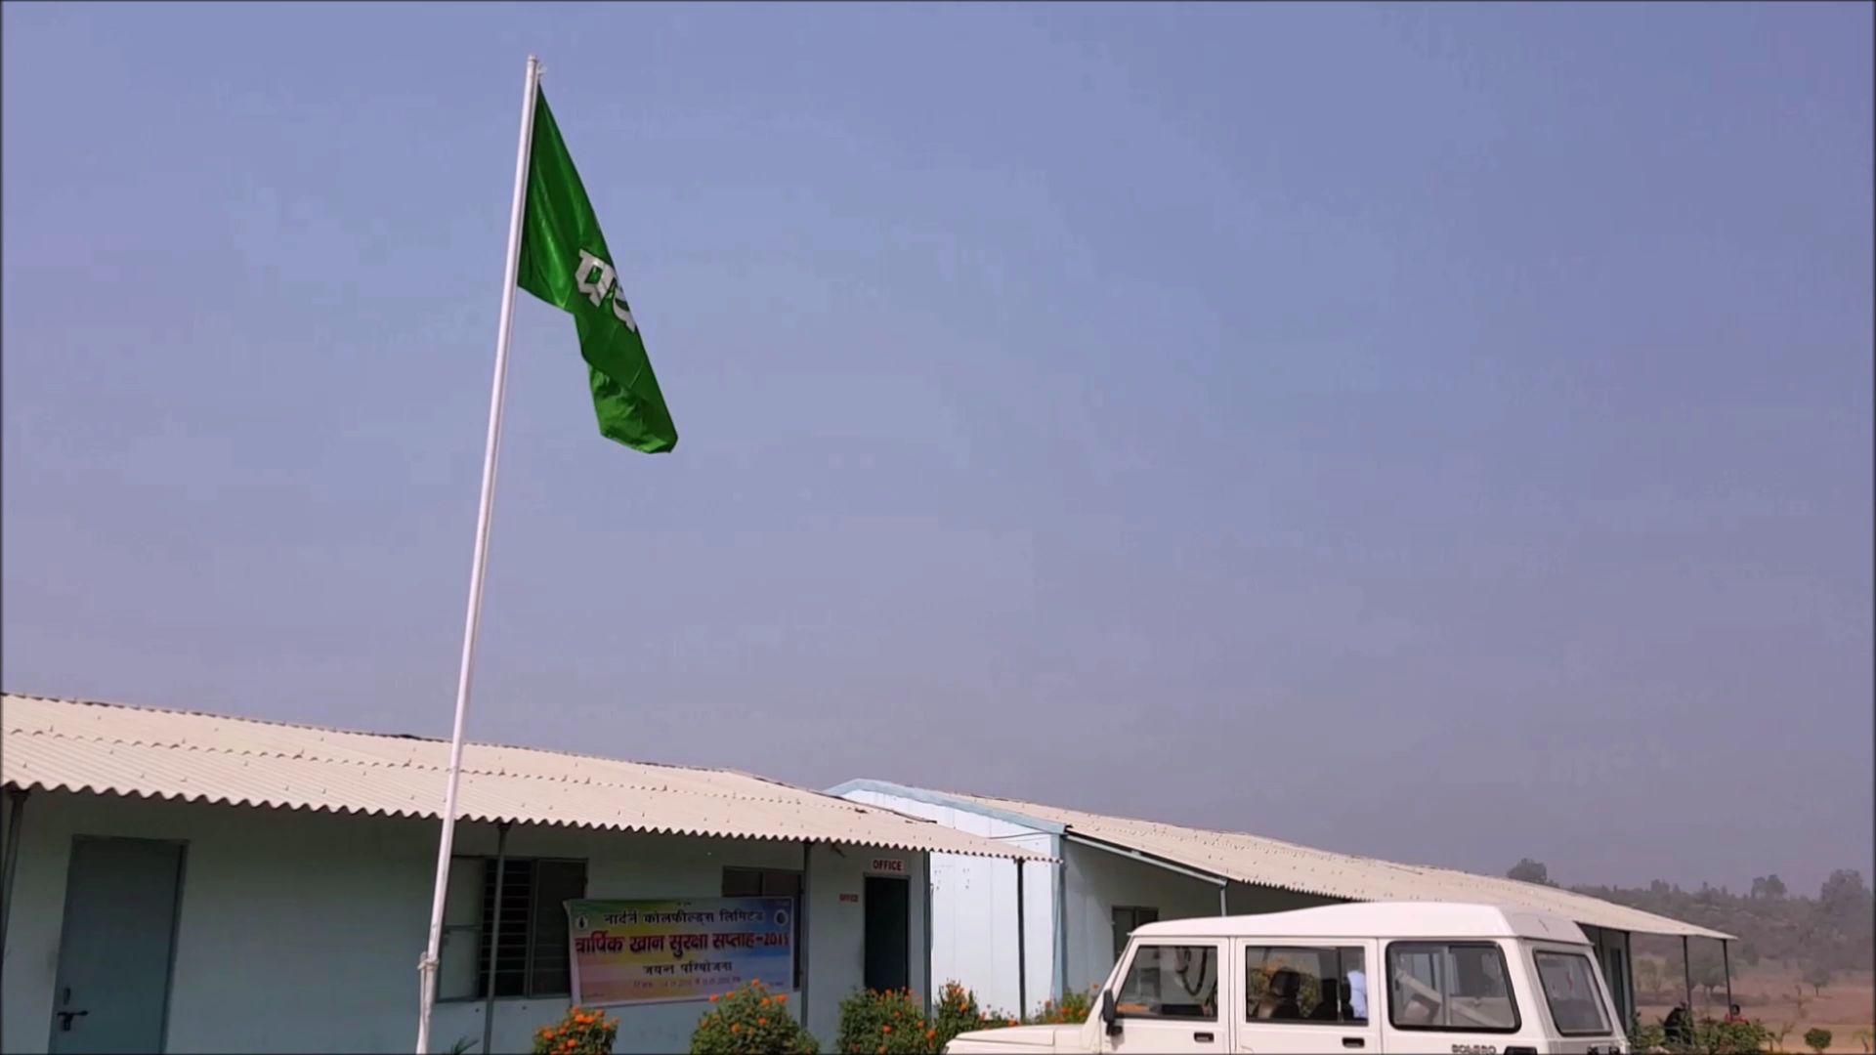
OUR PLEDGE – EVERY DAY IS THE SAFE DAY AT VPR MINING.

Slide 44
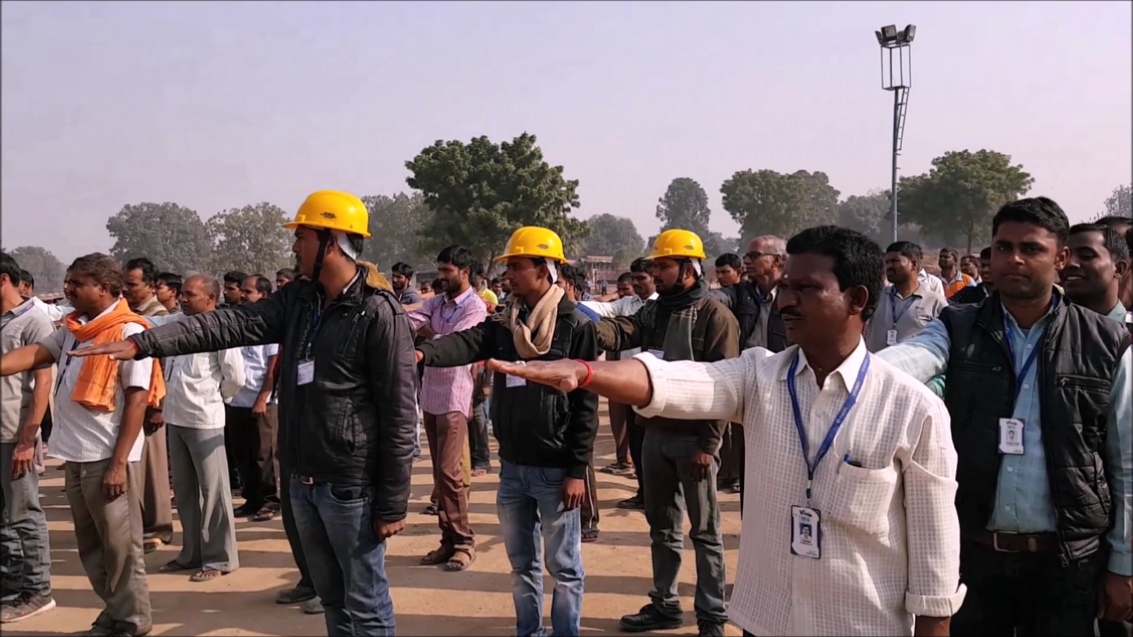
All Employees are part of VPR MINING safety campaign.

Slide 45
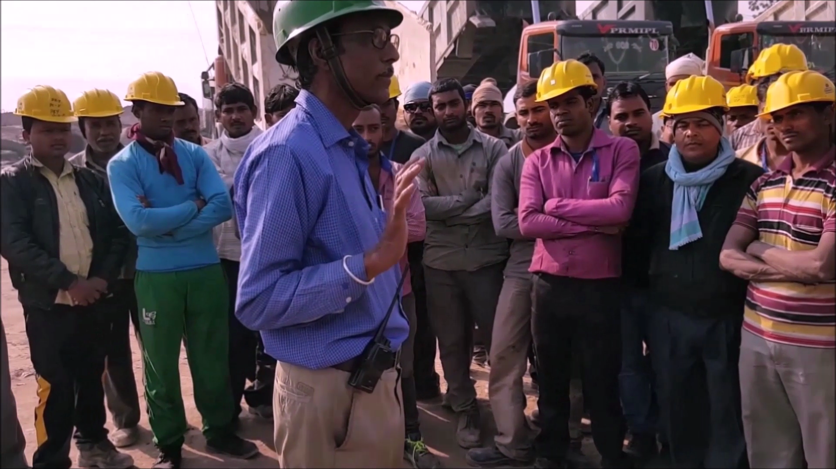
Instructions on Safety by Experts – Knowledge Enrichment in Safety.

Slide 46
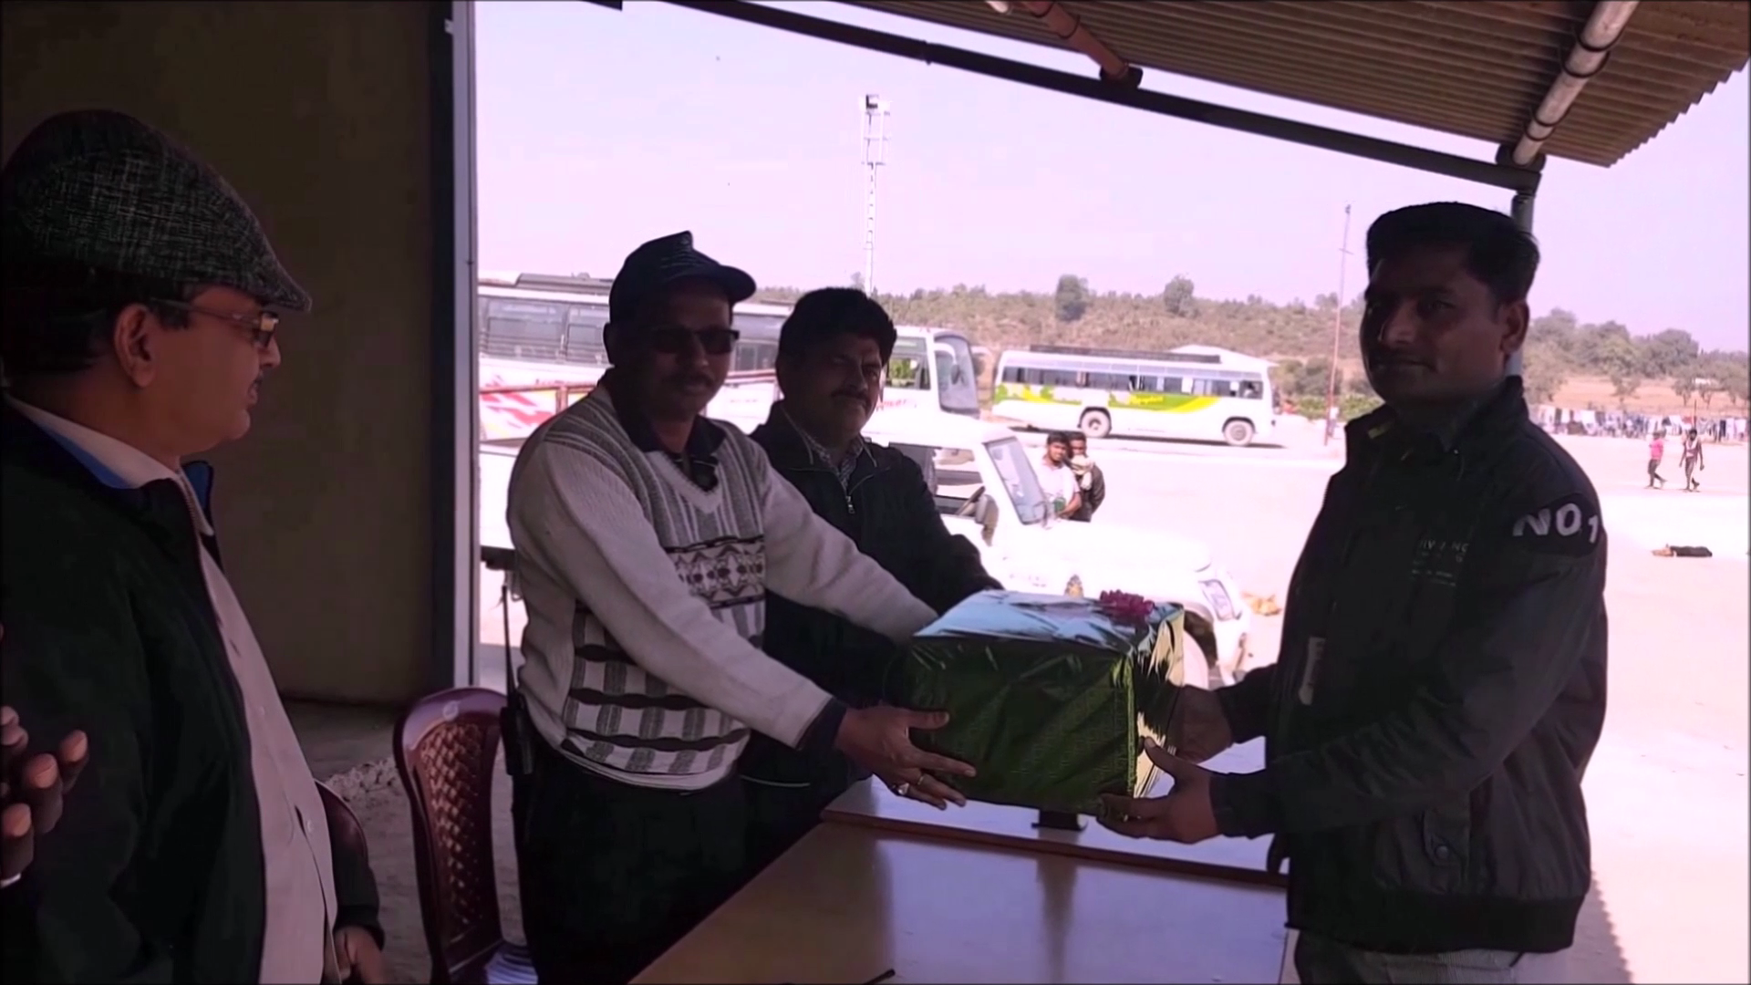
Safety Champions – Rewarded.

Slide 47
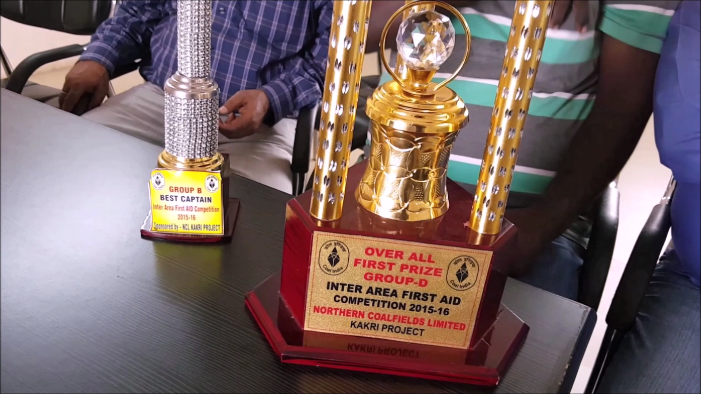
SAFETY AWARD IN 2016 – VPR MINING A PIONEER IN SAFE MINING.

